Slide 1

CS 484 Intro to Machine Learning
Week 9
October 21, 2020

Slide 2
Week 9 Agenda: Feature Selection
Mid-Term Test Recap
Feature Avoidance / Selection
Feature Importance Index
Chapter 9 of the Next Edition of the Machine Learning book

Slide 3
Mid-Term Test Question 1
Based on the MNLogit output below, what statistical phenomenon may have happened?
Optimization terminated successfully.
Current function value: 0.479393
Iterations 24
MNLogit Regression Results
==============================================================================
Dep. Variable: BAD No. Observations: 4981
Model: MNLogit Df Residuals: 4973
Method: MLE Df Model: 7
Date: Mon, 02 Mar 2020 Pseudo R-squ.: 0.06869
Time: 11:21:49 Log-Likelihood: -2387.9
converged: True LL-Null: -2564.0
Covariance Type: nonrobust LLR p-value: 4.104e-72
==================================================================================
BAD=1 coef std err z P>|z| [0.025 0.975]
----------------------------------------------------------------------------------
const -0.8412 nan nan nan nan nan
REASON_DebtCon -0.5134 1.26e+06 -4.06e-07 1.000 -2.48e+06 2.48e+06
REASON_HomeImp -0.3278 1.37e+06 -2.39e-07 1.000 -2.69e+06 2.69e+06
JOB_Mgr -0.0073 7.27e+05 -1.01e-08 1.000 -1.42e+06 1.42e+06
JOB_Office -0.7000 7.27e+05 -9.63e-07 1.000 -1.42e+06 1.42e+06
JOB_Other -0.0939 7.27e+05 -1.29e-07 1.000 -1.42e+06 1.42e+06
JOB_ProfExe -0.5037 7.27e+05 -6.93e-07 1.000 -1.42e+06 1.42e+06
JOB_Sales 0.4530 7.27e+05 6.23e-07 1.000 -1.42e+06 1.42e+06
JOB_Self 0.0106 7.27e+05 1.46e-08 1.000 -1.42e+06 1.42e+06
DEROG 0.6917 0.049 14.167 0.000 0.596 0.787
==================================================================================
(A) The complete separation
(B) The quasi-complete separation
(C) The iteration did not converge
(D) Nothing unusual has happened
First, something unusual has happened. The iteration did converge, so it is not C. Since the log-likelihood value is not zero, we can rule out the complete separation phenomenon. Finally, the correct answer is B.

Slide 4
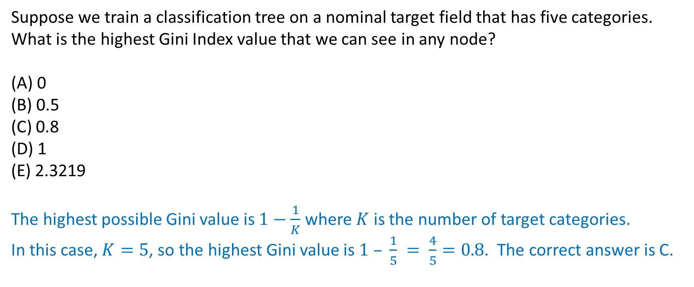
Mid-Term Test Question 2
Suppose we train a classification tree on a nominal target field that has five categories. What is the highest Gini Index value that we can see in any node?
(A) 0
(B) 0.5
(C) 0.8
(D) 1
(E) 2.3219
The highest possible Gini value is $1−\frac{1}{K}$ where $K$ is the number of target categories.
In this case, $K=5$, so the highest Gini value is $1 – \frac{1}{5} = \frac{4}{5}=0.8$. The correct answer is C.

Slide 5
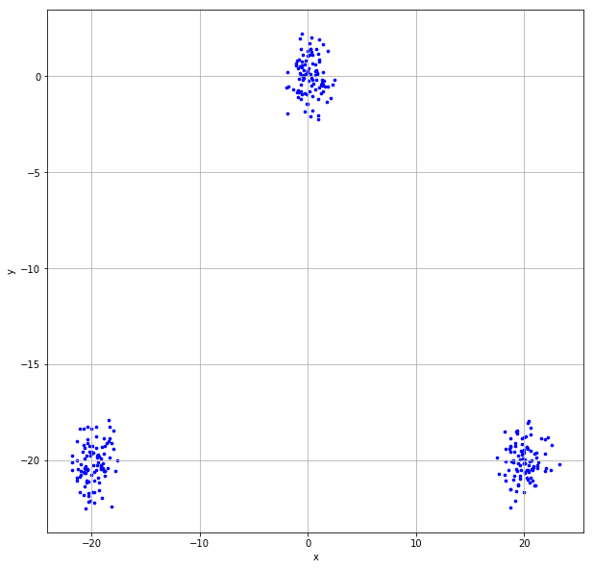
Mid-Term Test Question 3
We have generated the following scatterplot of two fields x and y. Suppose we are going to perform the K-means clustering analysis on the data in the scatterplot. Which of the following statements is valid about the Silhouette value for the 3-cluster solution?
(A) Close to the negative one
(B) About zero
(C) Close to one
(D) Close to three
(E) Cannot be determined
Since the scatterplot clearly shows three non-overlapping clusters of observations, the Silhouette value for this 3-cluster solution should be close to the maximum Silhouette value which is one. Therefore, the correct answer is C. Indeed, the Silhouette value is 0.9368.

Slide 6
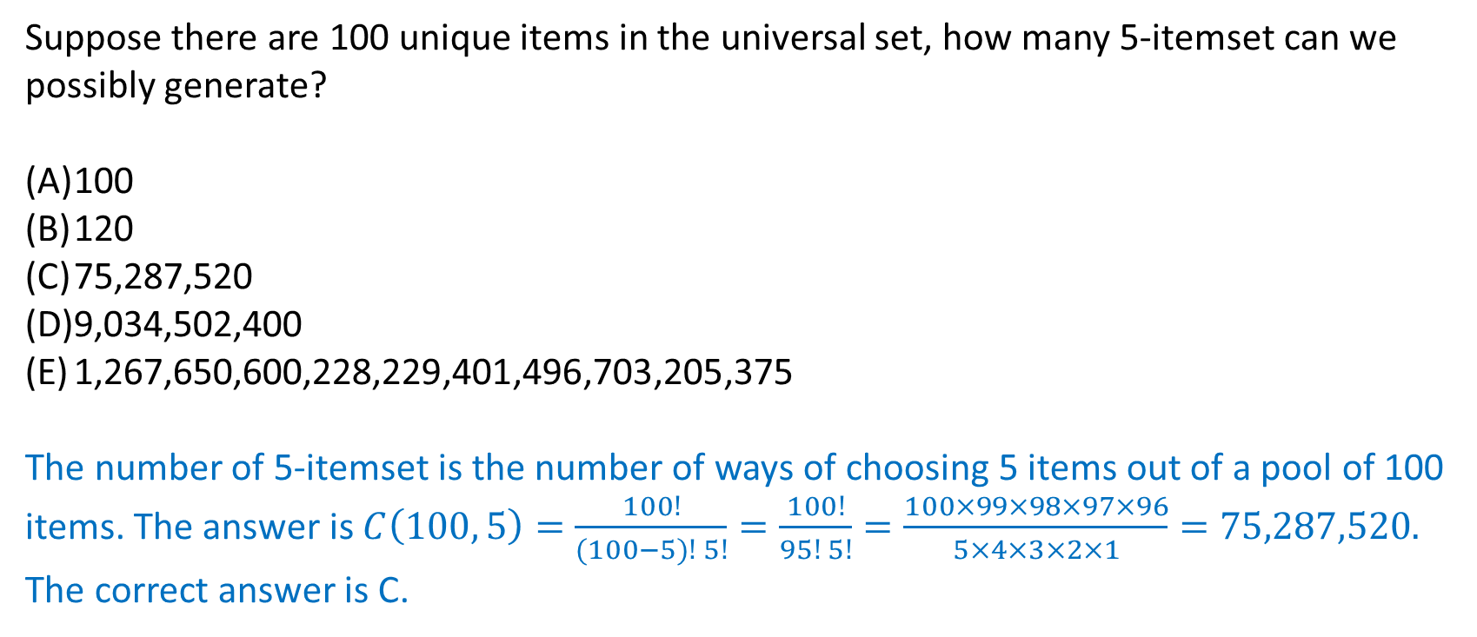
Mid-Term Test Question 4
Suppose there are 100 unique items in the universal set, how many 5-itemset can we possibly generate?
100
120
75,287,520
9,034,502,400
1,267,650,600,228,229,401,496,703,205,375
The number of 5-itemset is the number of ways of choosing 5 items out of a pool of 100 items. The answer is $C\left(100, 5\right)=\frac{100!}{(100−5)! 5!}=\frac{100!}{95! 5!}=\frac{100×99×98×97×96}{5×4×3×2×1}=75,287,520.$ The correct answer is C.

Slide 7
Mid-Term Test Question 5
The CSV file 2020S2MT_Q5.csv contains 100 values. Suppose we constructed a histogram on these 100 values with a bin-width of 5. What is the empirical density for the bin where the mid-point is x = 97.5?
A half of bin-width is 5/2 = 2.5. The bin is defined by this left-opened interval (97.5 – 2.5, 97.5 + 2.5] = (95, 100]. There are 15 observations in this bin. Therefore, the empirical density for the bin where the mid-point is x = 97.5 is 15 / (5 * 100) = 15 / 500 = 0.03.

Slide 8
Mid-Term Test Question 6
The support of the Consequent of an association rule X → Y is numerically equal to the Expected Confidence of the association rule.
True or False?
The expected confidence of an association rule is numerically equal to the support of the consequent. The answer is True.

Slide 9
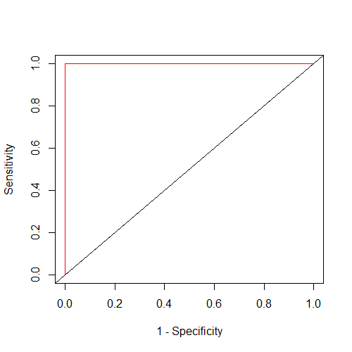
Mid-Term Test Question 7
Suppose we trained a binary classification model and the Area Under Curve value is one. Then what is the Sensitivity value when the False Positive Rate is 37.5%?
0%
37.5%
50%
100%
Cannot be determined
The Received Operating Characteristic (ROC) plots the Sensitivity value versus the One-Minus-Specificity value. The One-Minus-Specificity value is the False Positive Rate. When the Area Under Curve value is one, the Receiver Operating Characteristic (ROC) curve has a special form. It goes straight up from the (0%, 0%) coordinates to the (0%, 100%) coordinates, and the crosses horizontally to the (100%, 100%) coordinates. Therefore, for any False Positive Rate that is greater than 0%, the Sensitivity value is always 100%. The correct answer is D.

Slide 10
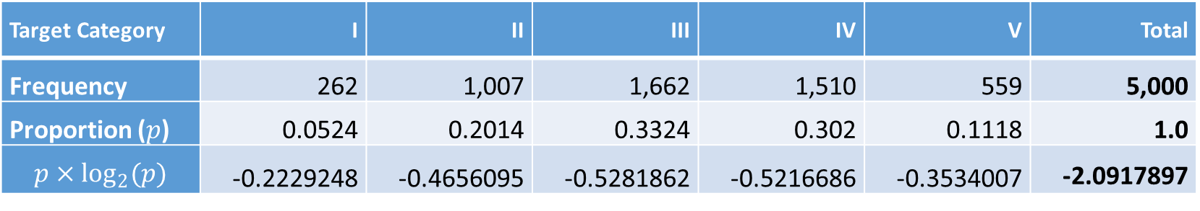

Mid-Term Test Question 8
Suppose we trained a classification tree using 5,000 observations. The target field has five categories whose frequencies are listed below. What is the Entropy value of the root node?
The following table shows the steps in getting the answer.
Target Category | I | II | III | IV | V | Total
Frequency | 262 | 1,007 | 1,662 | 1,510 | 559 | 5,000
Proportion ($p$) | 0.0524 | 0.2014 | 0.3324 | 0.302 | 0.1118 | 1.0
$$p×\log_{2}(p)$$ | -0.2229248 | -0.4656095 | -0.5281862 | -0.5216686 | -0.3534007 | -2.0917897
The Entropy value of the root node is $−\sum{\left(p×\log_{2}\left(p\right)\right)}=$ 2.0918.

Slide 11
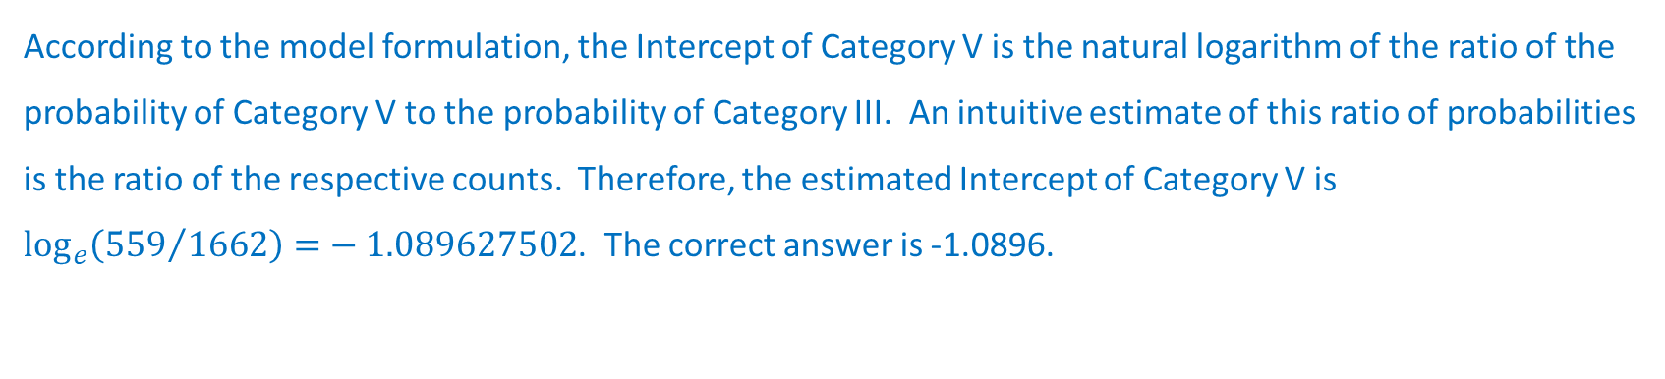
Mid-Term Test Question 9
We observed 5,000 observations for a target field that has five categories. The categories are I, II, III, IV, and V. The following table shows their frequencies. We trained a multinomial logistic model that contains only the Intercept terms. Suppose the reference target category is Category III. What is the estimated Intercept of Category V?
Target Category | I | II | III | IV | V
Frequency | 262 | 1,007 | 1,662 | 1,510 | 559
According to the model formulation, the Intercept of Category V is the natural logarithm of the ratio of the probability of Category V to the probability of Category III. An intuitive estimate of this ratio of probabilities is the ratio of the respective counts. Therefore, the estimated Intercept of Category V is $\log_{e}\left({559}/{1662}\right)=−1.089627502$. The correct answer is -1.0896.

Slide 12
Mid-Term Test Question 10
Friend | Items
Andrew | Cheese, Cracker, Salsa, Soda, Tortilla, Wings
Betty | Cheese, Soda, Tortilla
Carl | Cheese, Ice Cream, Soda, Wings
Danny | Cheese, Ice Cream, Salsa, Tortilla, Wings
Emily | Salsa, Soda, Tortilla, Wings
Frank | Cheese, Cracker, Ice Cream, Soda, Wings
I invited six friends to my home to watch a basketball game. My friends brought snacks and beverages along.
I noticed that a few of my friends brought Cheese, Soda, and Wings together. Since I prefer to spend your money on other food besides Wings, I am curious to know how likely my friends will bring Wings if they have already brought Cheese and Soda. Therefore, please help me determine the Lift of this association rule {Cheese, Soda} ==> {Wings}.
The Conference of this rule is Prob(Cheese, Soda, Wings) / Prob(Cheese, Soda) = (3/6) / (4/6) = 3/4. The Expected Conference of this rule is Prob(Wings) = 5/6. Therefore, the Lift = Conference / (Expected Conference) = (3/4) / (5/6) = 9/10 = 0.9.

Slide 13
Mid-Term Test Question 11
Given the following confusion matrix, what is the F1 Score value?
Precision = 18 / (18 + 12) = 0.6 and Recall = 18 / (18 + 7) = 0.72. The F1 Score is the harmonic mean of Precision and Recall. Therefore, F1 Score is 2 / (1/0.6 + 1/0.72) = 0.6545.
 | Predicted Event | Predicted Non-Event
Observed Event | 18 | 7
Observed Non-Event | 12 | 22

Slide 14
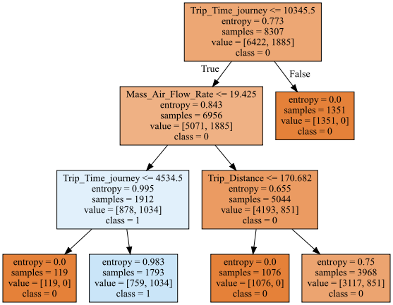
Mid-Term Test Question 12
We are given the following classification tree diagram. The target variable has two categories 0 and 1.
Suppose we are interested in predicting the class 1 of the target variable. In other words, the predicted event probability is the Prob (class = 1). What is the Root Average Squared Error?

Slide 15
Mid-Term Test Question 12 (continued)
The decision tree has five leaves. The following table shows the steps in obtaining the answer.
The overall number of observations is 8307. The overall sum of squared error is 1106.1951888. The average squared error (ASE) is 1106.1951888 / 8307 = 0.1331642. Finally, the root average squared error (RASE) is 0.3649.
Leaf | Number of Observations |  | Predicted Event Probability | Sum of Squared Error
 | Non-Event (class = 0) | Event (class = 1) |  | Non-Event (class = 0) | Event (class = 1)
1 | 1351 | 0 | 0 | 0 | 0
2 | 119 | 0 | 0 | 0 | 0
3 | 759 | 1034 | 1034/(759+1034) = 0.5766871 | 759*(0-0.5766871)^2 = 252.4191351 | 1034*(1-0.5766871)^2 =185.2863864
4 | 1076 | 0 | 0 | 0 | 0
5 | 3117 | 851 | 0.2144657 | 143.3681217 | 525.1215456

Slide 16
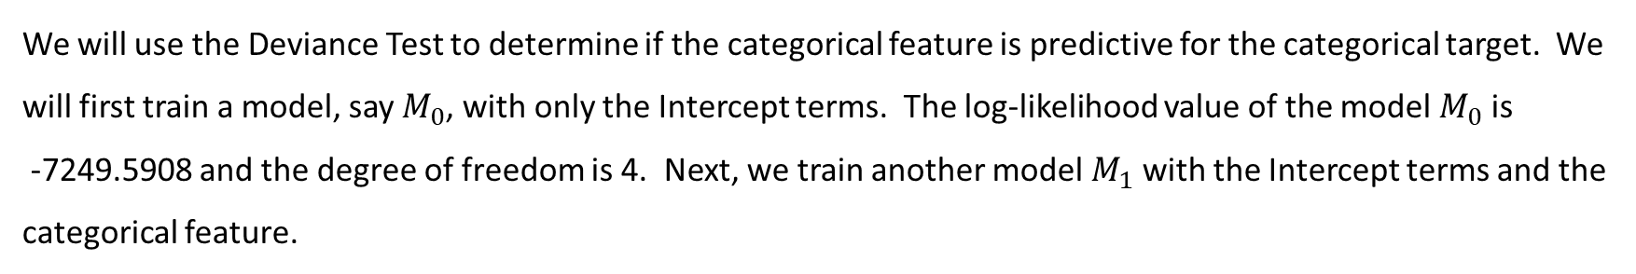
Mid-Term Test Question 13, 14, and 15
We are going to train a multinomial logistic regression on 5,000 observations. The target field has five categories, namely, A, B, C, D, and E. The categorical feature has four categories, namely, I, II, III, and IV. Instead of a casewise dataset, the data have been aggregated and shown in the following table.
 | Target Field
Feature | A | B | C | D | E
I | 65 | 304 | 530 | 487 | 140
II | 74 | 185 | 160 | 55 | 16
III | 33 | 228 | 623 | 755 | 363
IV | 90 | 290 | 349 | 213 | 40
We will use the Deviance Test to determine if the categorical feature is predictive for the categorical target. We will first train a model, say $M_{0}$, with only the Intercept terms. The log-likelihood value of the model $M_{0}$ is -7249.5908 and the degree of freedom is 4. Next, we train another model $M_{1}$ with the Intercept terms and the categorical feature.

Slide 17
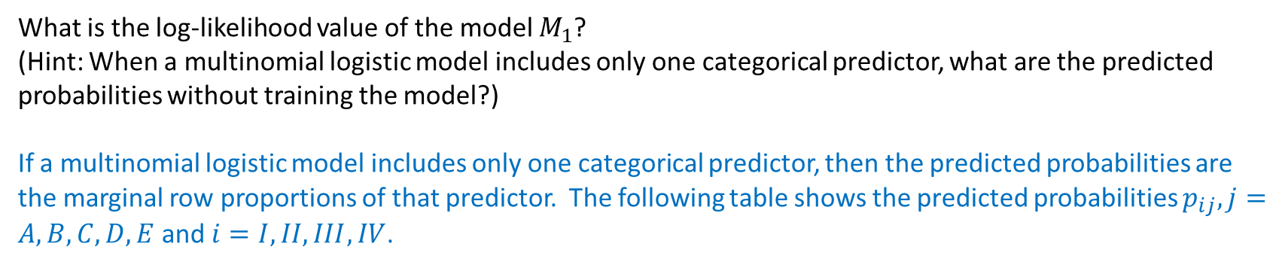

Mid-Term Test Question 13
What is the log-likelihood value of the model $M_{1}$?
(Hint: When a multinomial logistic model includes only one categorical predictor, what are the predicted probabilities without training the model?)
If a multinomial logistic model includes only one categorical predictor, then the predicted probabilities are the marginal row proportions of that predictor. The following table shows the predicted probabilities $p_{ij},j=A, B,C,D,E$ and $i=I,II,III,IV$.
Feature | A | B | C | D | E | Total
I | 0.0425950 | 0.1992136 | 0.3473132 | 0.3191350 | 0.0917431 | 1
II | 0.1510204 | 0.3775510 | 0.3265306 | 0.1122449 | 0.0326531 | 1
III | 0.0164835 | 0.1138861 | 0.3111888 | 0.3771229 | 0.1813187 | 1
IV | 0.0916497 | 0.2953157 | 0.3553971 | 0.2169043 | 0.0407332 | 1
The log-likelihood value of this model $M_{1}$ is $\sum_{i=I}^{IV}{\sum_{j=A}^{E}{n_{ij}\log_{e}\left(p_{ij}\right)}}=−6918.5162$.

Slide 18
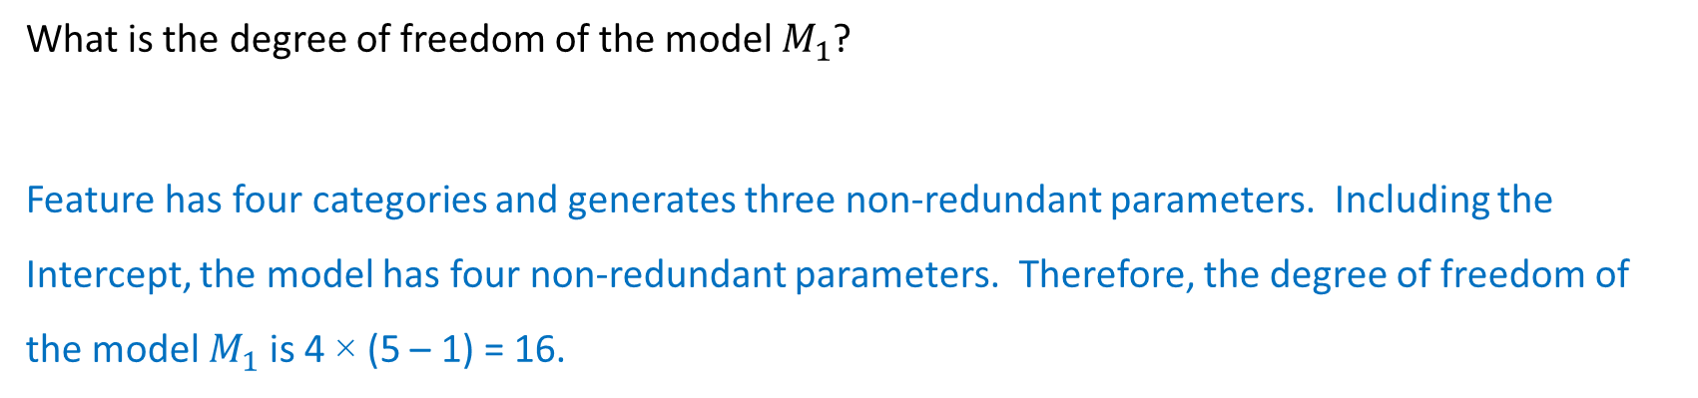
Mid-Term Test Question 14
What is the degree of freedom of the model $M_{1}$?
Feature has four categories and generates three non-redundant parameters. Including the Intercept, the model has four non-redundant parameters. Therefore, the degree of freedom of the model $M_{1}$ is 4 × (5 – 1) = 16.

Slide 19
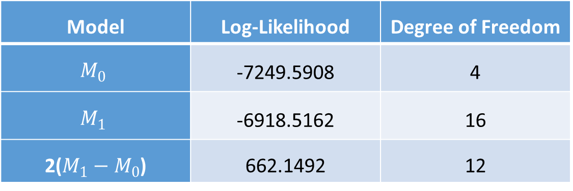
Mid-Term Test Question 15
What is the Chi-square significance value of the Deviance Test?
1.4536E-130
5.5356E-134
1.3696E-63
1.0
None of the Above
In the Deviance test, the Chi-square statistic is 662.1492, the degree of freedom is 12, and the significance value is 5.5356011E-134. Therefore, the correct answer is B.
Model | Log-Likelihood | Degree of Freedom
$$M_{0}$$ | -7249.5908 | 4
$$M_{1}$$ | -6918.5162 | 16
2($M_{1}−M_{0}$) | 662.1492 | 12

Slide 20
Mid-Term Test Question 16
You are going to build a logistic model using the 20 observations below. The binary target field is y, and the interval predictor is x.
The specifications are:
The target event category is 1
The Intercept term is included
The optimization method is Newton
The maximum number of iterations is 100
The tolerance level is 1e-8.
x | 0 | 0 | 0 | 0 | 1 | 1 | 1 | 1 | 2 | 2 | 2 | 2 | 3 | 3 | 3 | 3 | 4 | 4 | 4 | 4
y | 0 | 0 | 0 | 0 | 0 | 0 | 0 | 0 | 0 | 0 | 0 | 1 | 0 | 0 | 1 | 1 | 0 | 1 | 1 | 1

Slide 21
Mid-Term Test Question 16 (continued)
The iteration converged in 7 iterations. The model summary is below.
MNLogit Regression Results
==============================================================================
Dep. Variable: y No. Observations: 20
Model: MNLogit Df Residuals: 18
Method: MLE Df Model: 1
Date: Tue, 13 Oct 2020 Pseudo R-squ.: 0.3771
Time: 12:24:58 Log-Likelihood: -7.6099
converged: True LL-Null: -12.217
Covariance Type: nonrobust LLR p-value: 0.002401
==============================================================================
y=1 coef std err z P>|z| [0.025 0.975]
------------------------------------------------------------------------------
const -4.5047 2.000 -2.253 0.024 -8.424 -0.586
x1 1.4675 0.668 2.197 0.028 0.158 2.777
==============================================================================

Slide 22
Mid-Term Test Question 16 (continued)
After you have built your model, you will apply them to the following test data and then calculate the misclassification rate metric. An observation will be classified as an event if the predicted event probability is greater than or equal to 0.3. What is the Misclassification Rate when the Logistic model is applied to the test data?
The predicted event probabilities of the test data are:
For the test data, the misclassification rate is 3/5 = 0.6.
x | 0 | 1 | 2 | 3 | 4
y | 1 | 0 | 1 | 0 | 1
x | 0 | 1 | 2 | 3 | 4
y | 1 | 0 | 1 | 0 | 1
Pr(y = 1) | 0.0109 | 0.0458 | 0.1722 | 0.4744 | 0.7966
Predicted Category | 0 | 0 | 0 | 1 | 1

Slide 23
Mid-Term Test Question 17 and 18
You can use Chicago’s 311 Service Request to report street potholes. After a request has been received, the Department of Transportation will first assess the severity of the pothole, and then schedule a road crew to fill up the pothole. After the pothole is filled, the service request will be closed.
You are provided with this CSV file ChicagoCompletedPotHole.csv for analyzing the city’s efforts to fill up street potholes. The data contains 17,912 observations. Each observation represents a completed request which was created between December 1, 2017 and March 31, 2018 and was completed between December 4, 2017 and September 12, 2018. The data has the following seven variables.
You will use the K-Means Clustering algorithm to identify clusters in the entire data with the following specifications.
Use log_{e}(N_POTHOLES_FILLED_ON_BLOCK), log_{e}(1 + N_DAYS_FOR_COMPLETION), LATITUDE, and LONGITUDE (i.e., you need to perform the transformations before clustering)
The maximum number of clusters is 10 and the minimum number of clusters is 2
The random seed is 20201014
Use both the Elbow and the Silhouette methods to determine the number of clusters

Slide 24
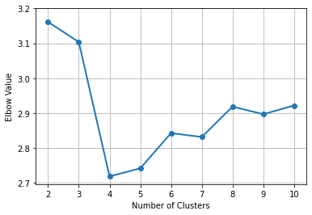
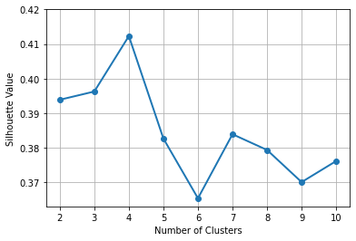
Mid-Term Test Question 17
What is the optimal number of clusters? Please give the number of clusters as an integer.
The Elbow and the Silhouette charts are shown on the right.
When the number of clusters is 4, an elbow appeared in the Elbow chart and a local maximum appeared in the Silhouette chart. Therefore, based on these two charts, we determined that the optimal number of clusters is 4.

Slide 25
Mid-Term Test Question 18
What is the Calinski-Harabasz Score for that optimal number of clusters?
When the number of clusters is 4, the Calinski-Harabasz Score is 17357.3587.

Slide 26
Mid-Term Test Question 19 and 20
In the automobile industry, a common question is how likely a policyholder will file a claim during the coverage period. Your task is to build a logistic model. To avoid discriminating policyholders, we will use predictors that can be verified and are related to the risk exposures of the policyholders. The CSV file policy_2001.csv contains data about 617 policyholders. We will use only the following variables.
Target Variable
CLAIM_FLAG: Claim Indicator (1 = Claim Filed, 0 = Otherwise) and 1 is the event value.
Nominal Predictor
CREDIT_SCORE_BAND: Credit Score Tier (‘450 – 619’, ‘620 – 659’, ‘660 – 749’, and ‘750 +’)
Interval Predictors
BLUEBOOK_1000: Blue Book Value in Thousands of Dollars (min. = 1.5, max. = 39.54)
CUST_LOYALTY: Number of Years with Company Before Policy Date (min. = 0, max. ≈ 21)
MVR_PTS: Motor Vehicle Record Points (min. = 0, max. = 10)
TIF: Time-in-Force (min. = 101, max. = 107)
TRAVTIME: Number of Miles Distance Commute to Work (min. = 5, max. ≈ 93)
Since the tools may not take the nominal predictor as is, you will first derive the dummy indicators from the nominal predictors and then use the dummy indicators in building the models. You will build the logistic model according to the following specifications.
The optimization algorithm is the Newton-Raphson method
The maximum number of iterations is 100
The relative error in parameter estimates acceptable for convergence is 1E-8
The Intercept term must be included in the model
Use the Forward Selection method to enter predictors, the alpha level is 0.05.
You will divide the data into the Training and the Test partitions. You will build the logistic model using the Training partition. Later, you will evaluate the model based on the Test partition.
Data Partition
The Training partition consists of 67% of the original observations, the remaining 33% goes to the Test partition.
Use the CLAIM_FLAG as the stratum variable.
The random seed is 20201014.

Slide 27
Mid-Term Test Question 19
Which predictors are selected into the final logistic model?
This table summarizes the selection steps.
Step | Model Specification | Number of Free Parameters | -2 * Log-likelihood | Deviance Test
 |  |  |  | Chi-Square | Degree of Freedom | Significance
0 | Intercept | 1 | -247.0853
1.1 | [0] + CREDIT_SCORE_BAND | 4 | -246.6267 | 0.9173 | 3 | 0.821241
1.2 | [0] + BLUEBOOK_1000 | 2 | -242.5056 | 9.1594 | 1 | 0.002474
1.3 | [0] + CUST_LOYALTY | 2 | -246.1361 | 1.8985 | 1 | 0.168243
1.4 | [0] + MVR_PTS | 2 | -238.5172 | 17.1363 | 1 | 0.000035
1.5 | [0] + TIF | 2 | -247.1219 | -0.0731 | 1 | 1
1.6 | [0] + TRAVTIME | 2 | -244.2462 | 5.6784 | 1 | 0.017175
1 | Intercept + MVR_PTS | 2 | -238.5172
2.1 | [1] + CREDIT_SCORE_BAND | 5 | -237.8812 | 1.2719 | 3 | 0.735810
2.2 | [1] + BLUEBOOK_1000 | 3 | -234.8334 | 7.3676 | 1 | 0.006641
2.3 | [1] + CUST_LOYALTY | 3 | -237.6778 | 1.6789 | 1 | 0.195077
2.4 | [1] + TIF | 3 | -238.4049 | 0.2247 | 1 | 0.635516
2.5 | [1] + TRAVTIME | 3 | -236.2361 | 4.5622 | 1 | 0.032685
2 | Intercept + MVR_PTS + BLUEBOOK_1000 | 3 | -234.8334
3.1 | [2] + CREDIT_SCORE_BAND | 6 | -234.1295 | 1.4078 | 3 | 0.703702
3.2 | [2] + CUST_LOYALTY | 4 | -234.0496 | 1.5676 | 1 | 0.210554
3.3 | [2] + TIF | 4 | -234.7396 | 0.1875 | 1 | 0.664969
3.4 | [2] + TRAVTIME | 4 | -232.3912 | 4.8844 | 1 | 0.027101
3 | Intercept + MVR_PTS + BLUEBOOK_1000 + TRAVTIME | 4 | -232.3912
4.1 | [3] + CREDIT_SCORE_BAND | 7 | -231.5442 | 1.6939 | 3 | 0.638282
4.2 | [3] + CUST_LOYALTY | 5 | -231.8385 | 1.1055 | 1 | 0.293056
4.3 | [3] + TIF | 5 | -232.4546 | -0.1267 | 1 | 1

Slide 28
Mid-Term Test Question 19
Which predictors are selected into the final logistic model?
A predictor will be selected into the model if its Significance value is less than or equal to 0.05. Based on this criterion, MVR_PTS entered in Step 1, BLUEBOOK_1000 in Step 2, and TRAVTIME entered in Step 3. No additional variables are entered after Step 3.

Slide 29
Mid-Term Test Question 20
What is the Area Under Curve value of the Testing Partition?
The Area Under Curve value of the Testing Partition is 0.5846.

Slide 30
Mid-Term Test Recap
43 out of 46 students submitted the test
Each student’s submission will be reviewed to determine whether partial credit should be given.

Slide 31
Feature Selection in Model Building
AVOID
SELECT
Intuitively think the features are good for model building
TRAIN
Features can be further examined and securitized
Subjectively withhold features from consideration

Slide 32
Why Select Feature in Model Building?
Personally Identifiable Information (PII) or Protected Health Information (PHI) are prohibited from being used for any predictive models
Resources (e.g., memory, disk space, processor speed) limit the number of features that can be fed into a computer program
Weakness in algorithms or flaws in implementation (e.g., dealing with collinearity, handling of missing values)

Slide 33
Avoid These Features (At least, seek an opinion before using them)
PII
Personally Identifiable Information
Any information that can be used to distinguish or trace an individual’s identity such as name, social security number, date and place of birth, mother’s maiden name, or biometric records
PHI
Protected Health Information
Any information in a medical record that can be used to identify an individual, including billing information, test results, prescription records, communication records, and scheduling records
Discriminatory
Features that challenge the state of fairness
The Equal Employment Opportunity Act (EEOA) of 1972 and the Age Discrimination in Employment Act (ADEA) of 1967
Beware of the General Data Protection Regulation (GDPR) in the European Union
Mandated by the Health Insurance Portability and Accountability Act of 1996 (HIPAA)
ADEA forbids age discrimination against people who are age 40 or older
EEOA prohibits employment discrimination based on race, color, religion, sex, or national origin

Slide 34
Use These Features At Your Own Risk
Single Category
A particular category occurs too often
Relative frequency of that category is equal to or above a threshold
Constant Value
The values are within a narrow range
Coefficient of Variation (Std.Dev. / Mean) is below a threshold
Missing Value
Majority of observations are missing
Percent of missing observations is above a threshold
Many Distinct Categories
Many categories occur rarely
Relative frequencies of the majority of categories are below a threshold
May consume lot of resources
Algorithm may not anticipate
May cause machine underflow
Algorithm may not handle

Slide 35

Required Feature Inclusion
Certain features are included whatsoever due to business practice in an industry
U.S. regions or census tracts for data that have a geographical element
Marketing incentives in studying customer purchase behavior

Slide 36
Need to Identify Helpful Features
Number of Features
From the viewpoint of a data scientist, too many features may be equally troublesome as too few features
Learner Algorithm
An algorithm is useful and effective only if it can take all the features that are specified, no matter how powerful it is
Identify the Helpful
Therefore, we need to identify the features that help predict the target accurately before specifying them in the algorithm

Slide 37
Identify the Helpful Features
Appropriate Statistical Test |  | Target Variable
 |  | Categorical | Interval
Input Feature | Categorical | Chi-square | ANOVA
 | Interval | Deviance | Regression

Slide 38
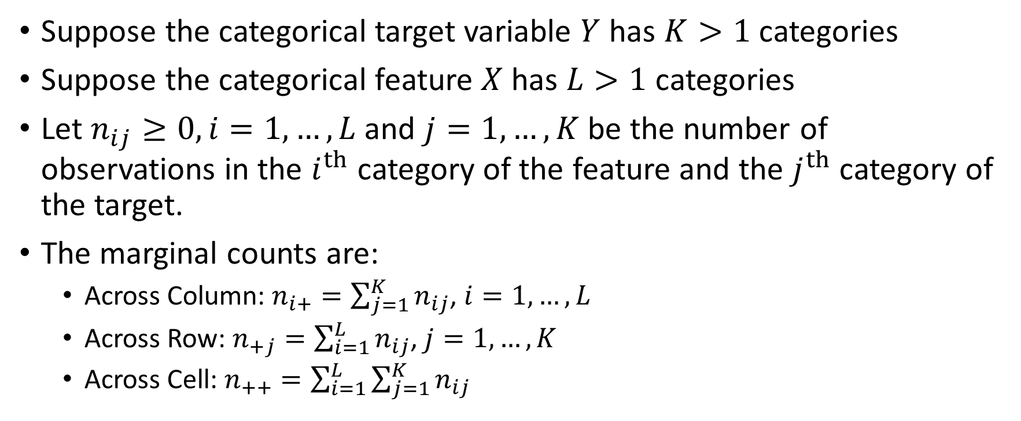
Chi-square Test
Suppose the categorical target variable $Y$ has $K>1$ categories
Suppose the categorical feature $X$ has $L>1$ categories
Let $n_{ij}≥0, i=1,…, L$ and $j=1,…,K$ be the number of observations in the $i^{th}$ category of the feature and the $j^{th}$ category of the target.
The marginal counts are:
Across Column: $n_{i+}=\sum_{j=1}^{K}{n_{ij}}$, $i=1,…, L$
Across Row: $n_{+j}=\sum_{i=1}^{L}{n_{ij}}$, $j=1,…,K$
Across Cell: $n_{++}=\sum_{i=1}^{L}{\sum_{j=1}^{K}{n_{ij}}}$

Slide 39
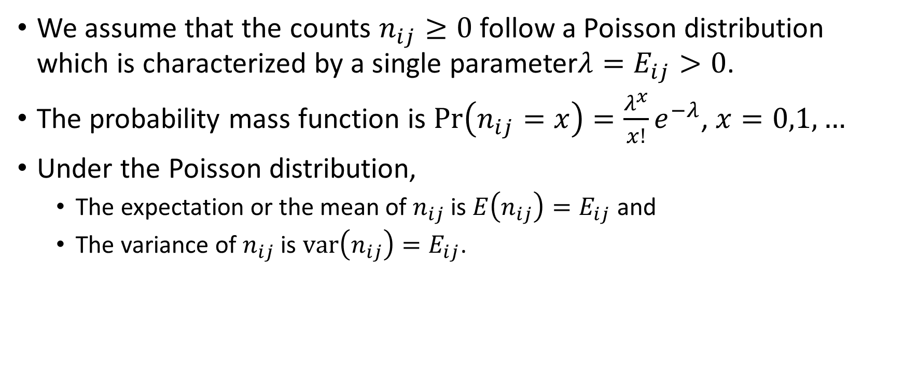
Chi-square Test – Poisson Distribution
We assume that the counts $n_{ij}≥0$ follow a Poisson distribution which is characterized by a single parameter$λ=E_{ij}>0$.
The probability mass function is $Pr\left(n_{ij}=x\right)=\frac{λ^{x}}{x!}e^{−λ}$, $x=0,1,…$
Under the Poisson distribution,
The expectation or the mean of $n_{ij}$ is $E\left(n_{ij}\right)=E_{ij}$ and
The variance of $n_{ij}$ is $var\left(n_{ij}\right)=E_{ij}$.

Slide 40
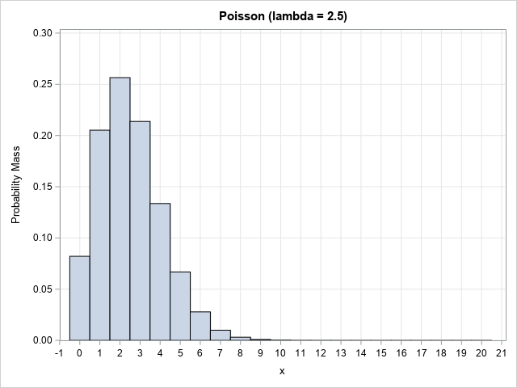
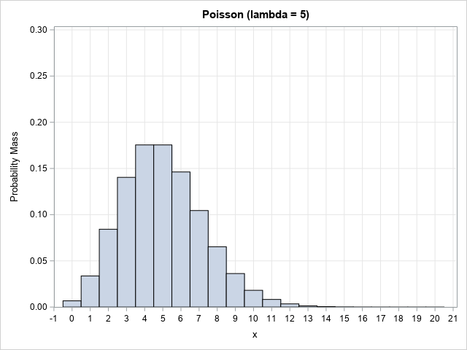
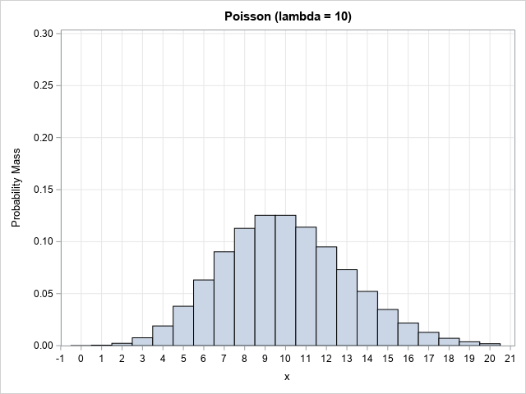
Poisson Distribution
Python Function | Density | Distribution | Significance | Quantile | Random Number
scipy.stats.poisson | .pmf() | .cdf() | .sf() | .ppf() | .rvs()

Slide 41
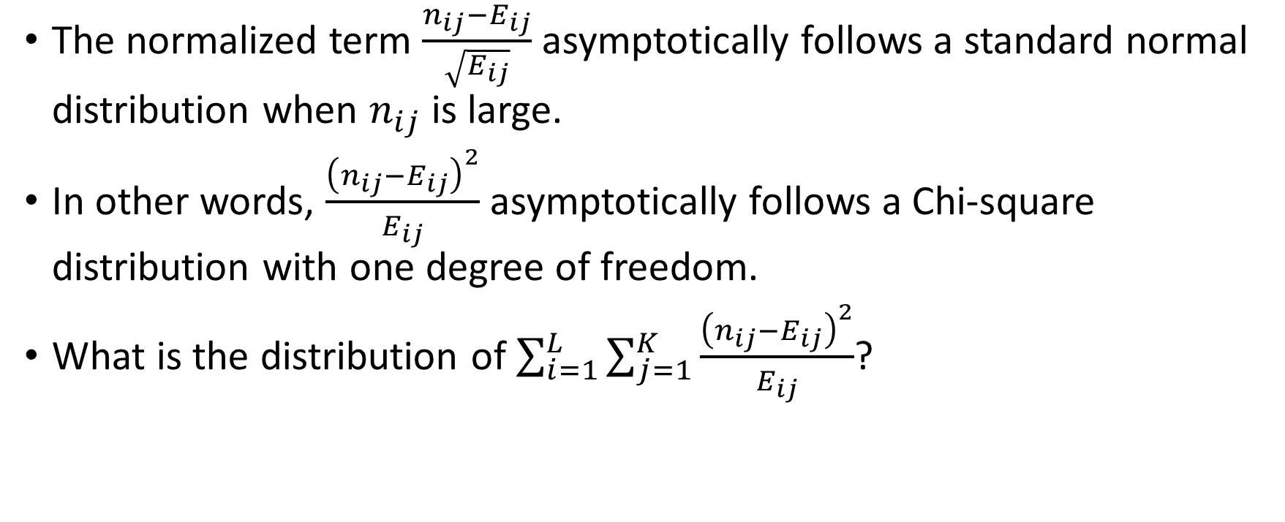
Chi-square Test
The normalized term $\frac{n_{ij}−E_{ij}}{\sqrt{E_{ij}}}$ asymptotically follows a standard normal distribution when $n_{ij}$ is large.
In other words, $\frac{{\left(n_{ij}−E_{ij}\right)}^{2}}{E_{ij}}$ asymptotically follows a Chi-square distribution with one degree of freedom.
What is the distribution of $\sum_{i=1}^{L}{\sum_{j=1}^{K}{\frac{{\left(n_{ij}−E_{ij}\right)}^{2}}{E_{ij}}}}$?

Slide 42
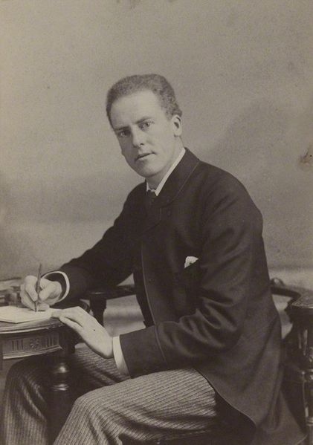
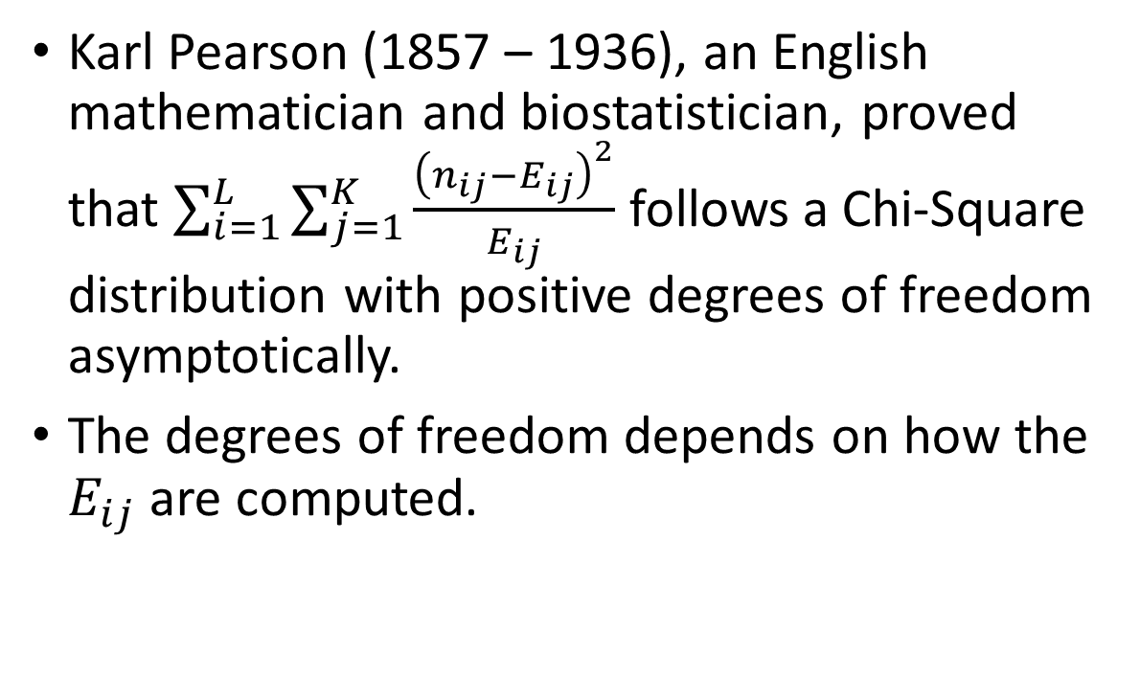
Chi-square Test
Karl Pearson (1857 – 1936), an English mathematician and biostatistician, proved that $\sum_{i=1}^{L}{\sum_{j=1}^{K}{\frac{{\left(n_{ij}−E_{ij}\right)}^{2}}{E_{ij}}}}$ follows a Chi-Square distribution with positive degrees of freedom asymptotically.
The degrees of freedom depends on how the $E_{ij}$ are computed.

Slide 43
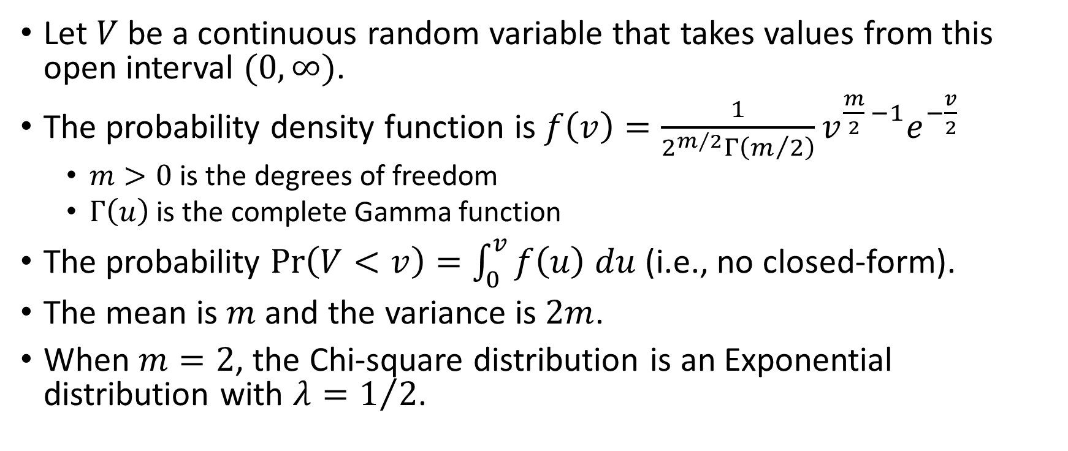
Chi-Square Distribution
Let $V$ be a continuous random variable that takes values from this open interval $(0,∞)$.
The probability density function is $f\left(v\right)=\frac{1}{2^{m/2}Γ\left(m/2\right)}v^{\frac{m}{2} −1}e^{−\frac{v}{2}}$
$m>0$ is the degrees of freedom
$Γ\left(u\right)$ is the complete Gamma function
The probability $Pr\left(V<v\right)=\int_{0}^{v}{f\left(u\right) du}$ (i.e., no closed-form).
The mean is $m$ and the variance is $2m$.
When $m=2$, the Chi-square distribution is an Exponential distribution with $λ=1/2$.

Slide 44
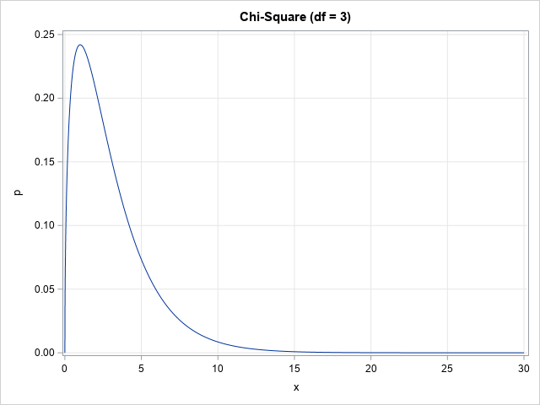
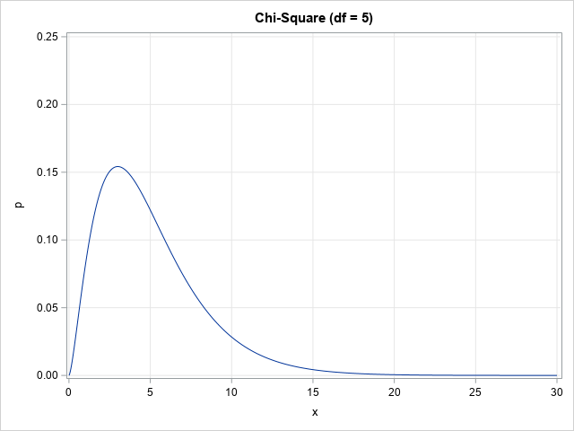
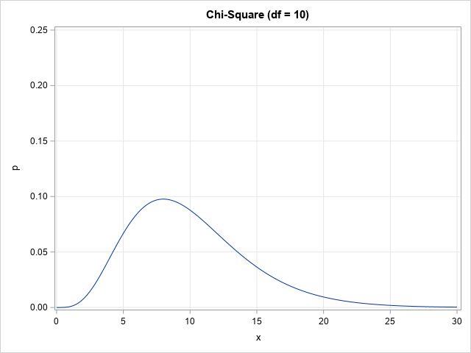
Chi-Square Distribution
Python Function | Density | Distribution | Significance | Quantile | Random Number
scipy.stats.chi2 | .pdf() | .cdf() | .sf() | .ppf() | .rvs()

Slide 45
Chi-square Test – Expected Count
Feature | Target
 | No | Yes | Total
A | 4 | 6 | 10
B | 2 | 3 | 5
C | 8 | 12 | 20
Total | 14 | 21 | 35
IF the feature is statistically independent of the target variable, then the feature will not help predict the target variable
THEN the relative frequencies (or percentages) across the target categories are the same for each feature’s category
THEREFORE, the common relative frequencies are be estimated by ${n_{+j}}/{n_{++}},j=1,…,K$
THEREFORE, the common relative frequencies are be estimated by 𝑛_(+𝑗)∕𝑛_(++) ,𝑗=1,…,𝐾
HENCE, the expected count in the $\left(i,j\right)$ cell is $E_{ij}=n_{i+}\frac{n_{+j}}{n_{++}}$
HENCE, the expected count in the (𝑖,𝑗) cell is 𝐸_𝑖𝑗=𝑛_(𝑖+) 𝑛_(+𝑗)/𝑛_(++)
Feature | Target
 | No | Yes | Total
A | 0.4 | 0.6 | 1
B | 0.4 | 0.6 | 1
C | 0.4 | 0.6 | 1
Total | 0.4 | 0.6 | 1

Slide 46
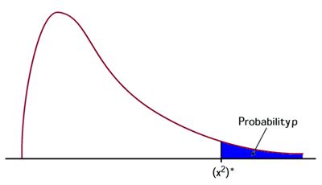
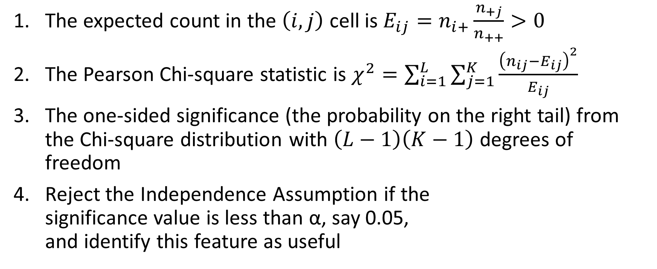
Chi-square Test - Procedure
The expected count in the $\left(i,j\right)$ cell is $E_{ij}=n_{i+}\frac{n_{+j}}{n_{++}}>0$
The Pearson Chi-square statistic is $χ^{2}=\sum_{i=1}^{L}{\sum_{j=1}^{K}{\frac{{\left(n_{ij}−E_{ij}\right)}^{2}}{E_{ij}}}}$
The one-sided significance (the probability on the right tail) from the Chi-square distribution with $\left(L−1\right)\left(K−1\right)$ degrees of freedom
Reject the Independence Assumption if the significance value is less than α, say 0.05, and identify this feature as useful

Slide 47
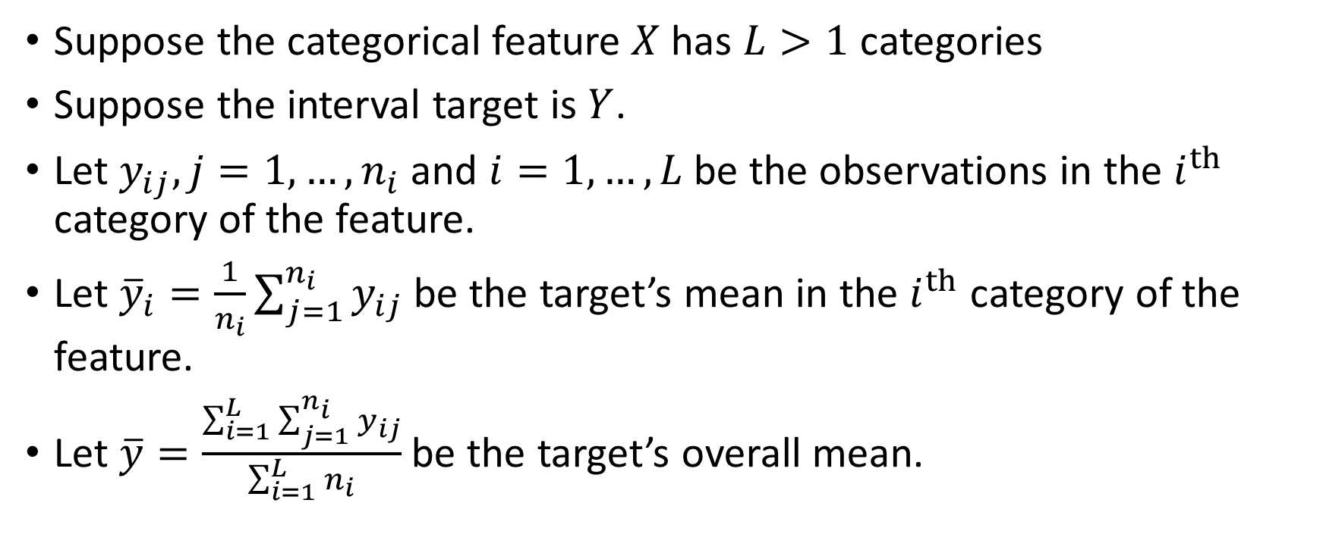
Analysis of Variance (ANOVA) Test
Suppose the categorical feature $X$ has $L>1$ categories
Suppose the interval target is $Y$.
Let $y_{ij}, j=1,…, n_{i}$ and $i=1,…, L$be the observations in the $i^{th}$ category of the feature.
Let ${\overline{y}}_{i}=\frac{1}{n_{i}}\sum_{j=1}^{n_{i}}{y_{ij}}$ be the target’s mean in the $i^{th}$ category of the feature.
Let $\overline{y}=\frac{\sum_{i=1}^{L}{\sum_{j=1}^{n_{i}}{y_{ij}}}}{\sum_{i=1}^{L}{n_{i}}}$ be the target’s overall mean.

Slide 48
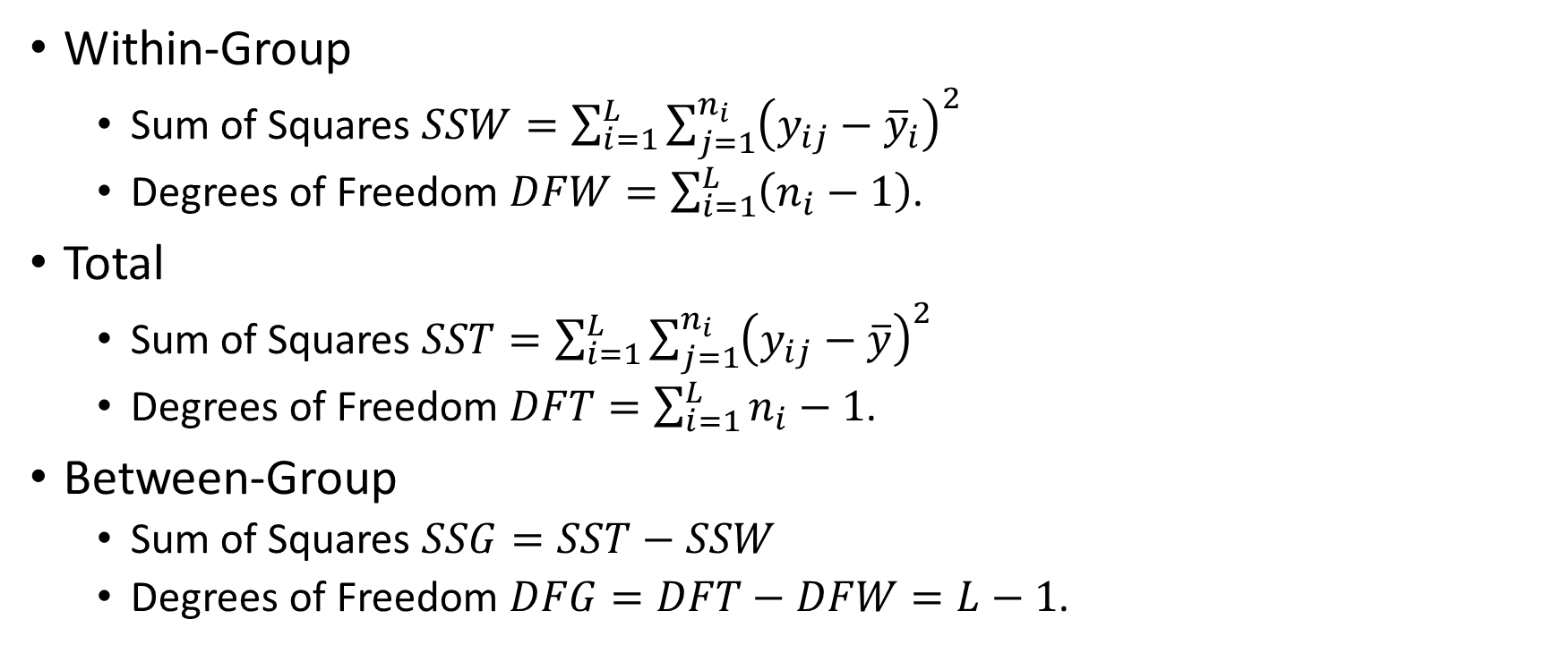
Analysis of Variance (ANOVA) Test
Within-Group
Sum of Squares $SSW=\sum_{i=1}^{L}{\sum_{j=1}^{n_{i}}{{\left(y_{ij}−{\overline{y}}_{i}\right)}^{2}}}$
Degrees of Freedom $DFW=\sum_{i=1}^{L}{\left(n_{i}−1\right)}$.
Total
Sum of Squares $SST=\sum_{i=1}^{L}{\sum_{j=1}^{n_{i}}{{\left(y_{ij}−\overline{y}\right)}^{2}}}$
Degrees of Freedom $DFT=\sum_{i=1}^{L}{n_{i}−1}$.
Between-Group
Sum of Squares $SSG=SST−SSW$
Degrees of Freedom $DFG=DFT−DFW=L−1$.

Slide 49
Analysis of Variance (ANOVA) Test
IF the feature is statistically independent of the target variable, then the feature will not help predict the target variable
THEN the target has the same mean across all feature’s categories
THEREFORE, both ${SSG}/{DFG}$ and ${SSW}/{DFW}$ both estimate the population variance.
THEREFORE, both 𝑆𝑆𝐺∕𝐷𝐹𝐺 and 𝑆𝑆𝑊∕𝐷𝐹𝑊 both estimate the population variance.
HENCE, the ratio $F=\frac{{SSG}/{DFG}}{{SSW}/{DFW}}$ follows a F distribution
HENCE, the ratio 𝐹=(𝑆𝑆𝐺∕𝐷𝐹𝐺)/(𝑆𝑆𝑊∕𝐷𝐹𝑊) follows a F distribution

Slide 50
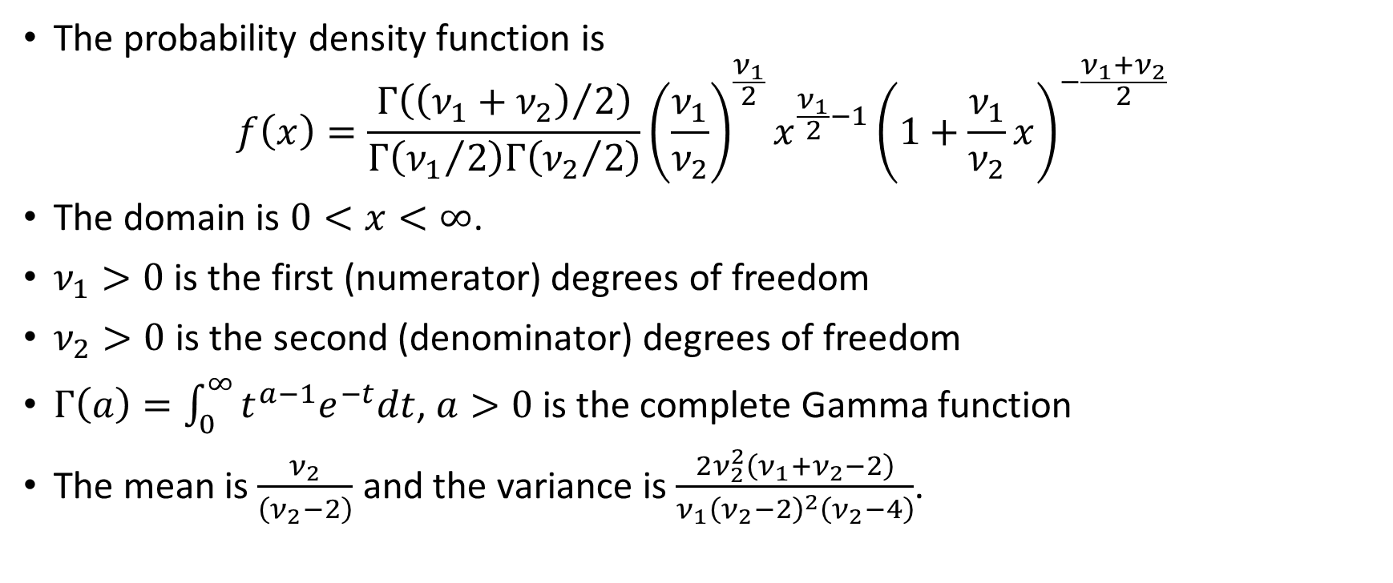
Continuous – F Distribution
The probability density function is
$$f\left(x\right)=\frac{Γ\left({\left(ν_{1}+ν_{2}\right)}/2\right)}{Γ\left({ν_{1}}/2\right)Γ\left({ν_{2}}/2\right)}{\left(\frac{ν_{1}}{ν_{2}}\right)}^{\frac{ν_{1}}{2}}x^{\frac{ν_{1}}{2}−1}{\left(1+\frac{ν_{1}}{ν_{2}}x\right)}^{−\frac{ν_{1}+ν_{2}}{2}}$$
The domain is $0<x<∞$.
$ν_{1}>0$ is the first (numerator) degrees of freedom
$ν_{2}>0$ is the second (denominator) degrees of freedom
$Γ\left(a\right)=\int_{0}^{∞}{t^{a−1}e^{−t}dt}$, $a>0$ is the complete Gamma function
The mean is $\frac{ν_{2}}{\left(ν_{2}−2\right)}$ and the variance is $\frac{2ν_{2}^{2}\left(ν_{1}+ν_{2}−2\right)}{ν_{1}{\left(ν_{2}−2\right)}^{2}\left(ν_{2}−4\right)}$.

Slide 51
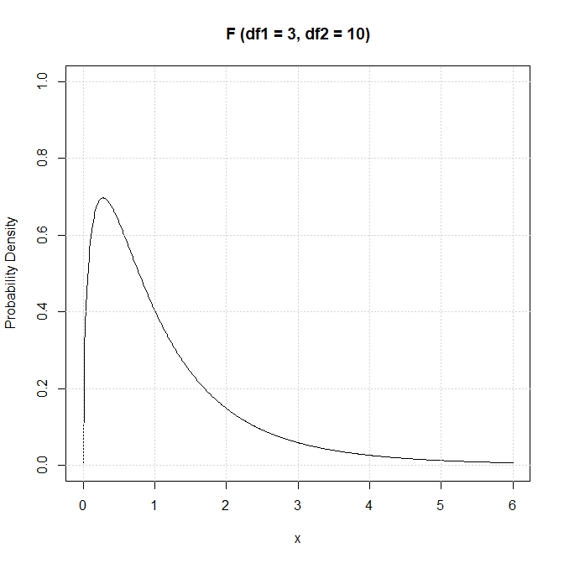
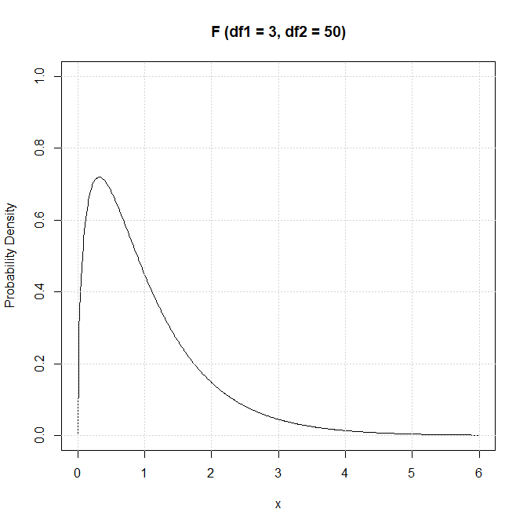
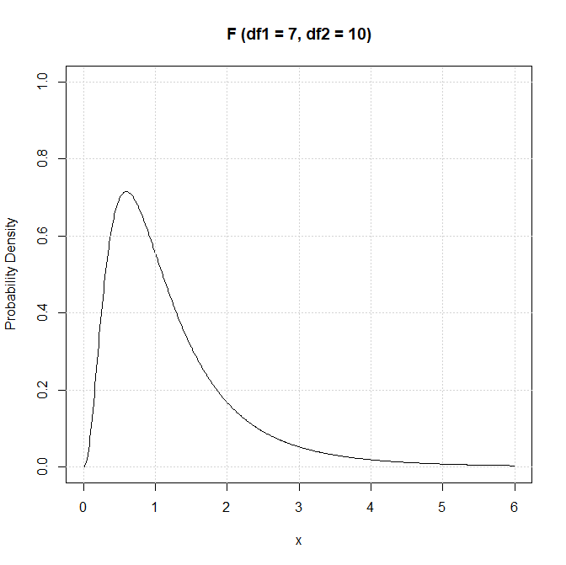
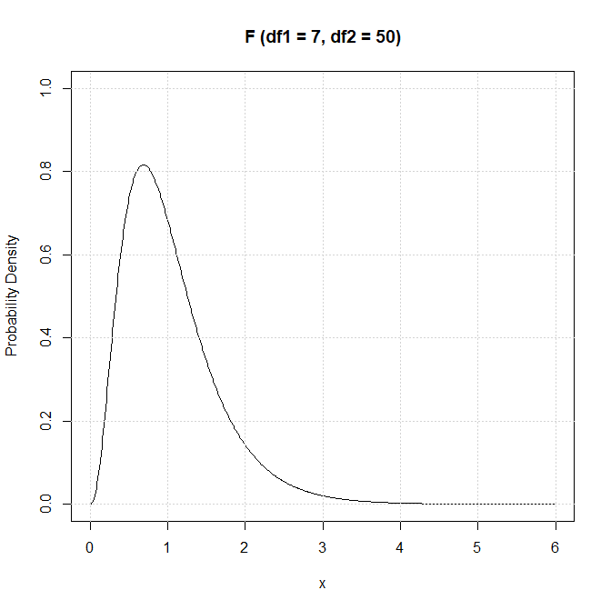
Continuous – F Distribution
Python Function | scipy.stats.f
Density | .pdf()
Distribution | .cdf()
Significance | .sf()
Quantile | .ppf()
Random Number | .rvs()

Slide 52
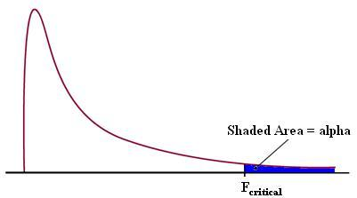
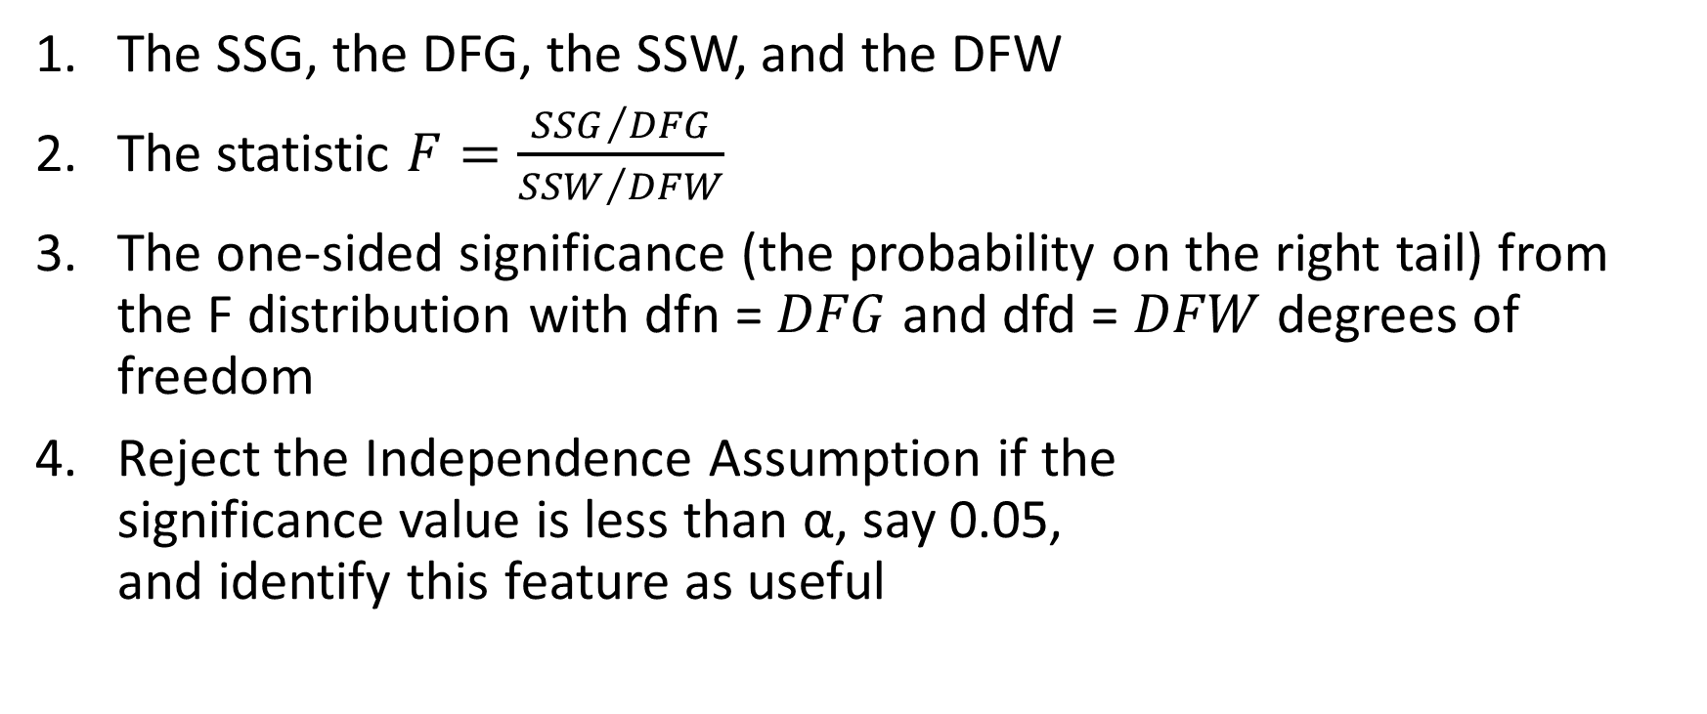
F Test - Procedure
The SSG, the DFG, the SSW, and the DFW
The statistic $F=\frac{{SSG}/{DFG}}{{SSW}/{DFW}}$
The one-sided significance (the probability on the right tail) from the F distribution with dfn = $DFG$ and dfd = $DFW$ degrees of freedom
Reject the Independence Assumption if the significance value is less than α, say 0.05, and identify this feature as useful

Slide 53
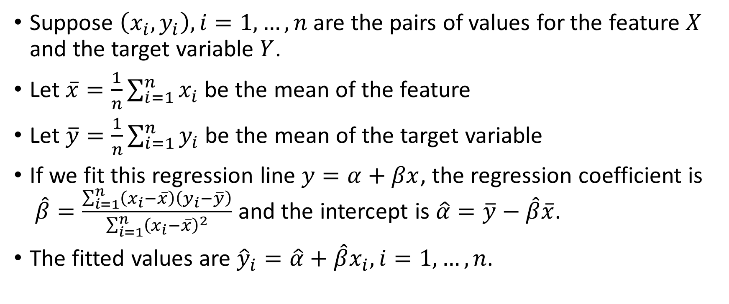
Regression Test
Suppose $\left(x_{i}, y_{i}\right), i=1,…,n$ are the pairs of values for the feature $X$ and the target variable $Y$.
Let $\overline{x}=\frac{1}{n}\sum_{i=1}^{n}{x_{i}}$ be the mean of the feature
Let $\overline{y}=\frac{1}{n}\sum_{i=1}^{n}{y_{i}}$ be the mean of the target variable
If we fit this regression line $y=α+βx$, the regression coefficient is $\hat{β}=\frac{\sum_{i=1}^{n}{\left(x_{i}−\overline{x}\right)\left(y_{i}−\overline{y}\right)}}{\sum_{i=1}^{n}{{\left(x_{i}−\overline{x}\right)}^{2}}}$ and the intercept is $\hat{α}=\overline{y}−\hat{β}\overline{x}$.
The fitted values are ${\hat{y}}_{i}=\hat{α}+\hat{β}x_{i},i=1,…,n$.

Slide 54
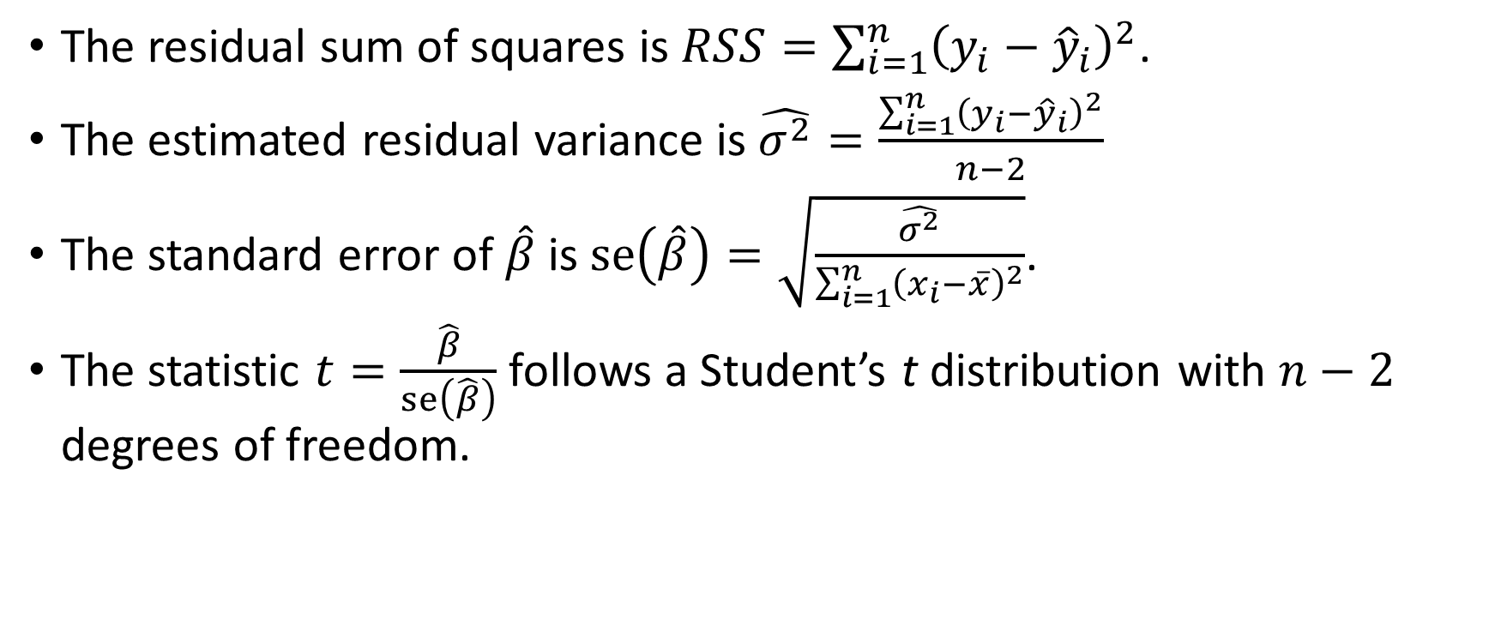
Regression Test
The residual sum of squares is $RSS=\sum_{i=1}^{n}{{\left(y_{i}−{\hat{y}}_{i}\right)}^{2}}$.
The estimated residual variance is $\hat{σ^{2}}=\frac{\sum_{i=1}^{n}{{\left(y_{i}−{\hat{y}}_{i}\right)}^{2}}}{n−2}$
The standard error of $\hat{β}$is $se\left(\hat{β}\right)=\sqrt{\frac{\hat{σ^{2}}}{\sum_{i=1}^{n}{{\left(x_{i}−\overline{x}\right)}^{2}}}}$.
The statistic $t=\frac{\hat{β}}{se\left(\hat{β}\right)}$ follows a Student’s t distribution with $n−2$ degrees of freedom.

Slide 55
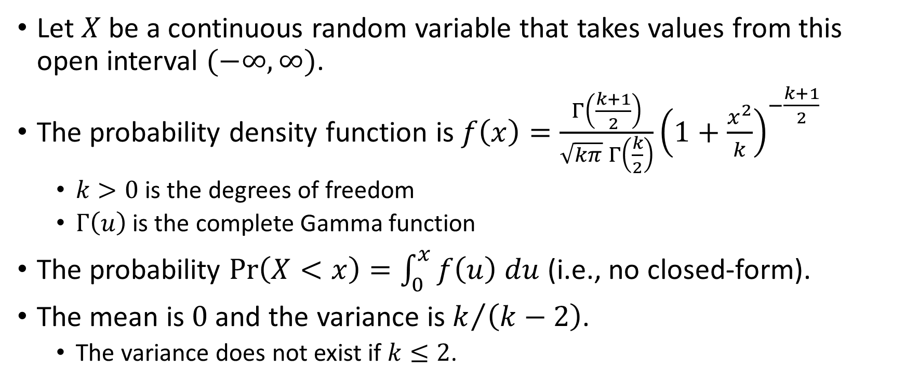
Continuous – Student’s t Distribution
Let $X$ be a continuous random variable that takes values from this open interval $(−∞,∞)$.
The probability density function is $f\left(x\right)=\frac{Γ\left(\frac{k+1}{2}\right)}{\sqrt{kπ} Γ\left(\frac{k}{2}\right)}{\left(1+\frac{x^{2}}{k}\right)}^{−\frac{k+1}{2}}$
$k>0$ is the degrees of freedom
$Γ\left(u\right)$ is the complete Gamma function
The probability $Pr\left(X<x\right)=\int_{0}^{x}{f\left(u\right) du}$ (i.e., no closed-form).
The mean is $0$ and the variance is $k/{\left(k−2\right)}$.
The variance does not exist if $k≤2$.

Slide 56
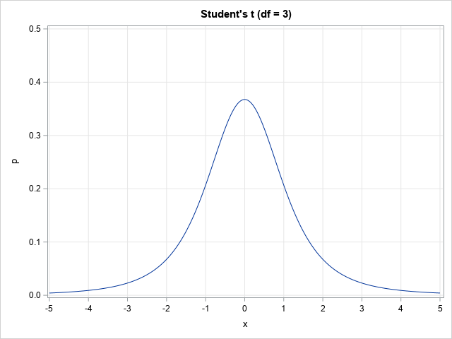
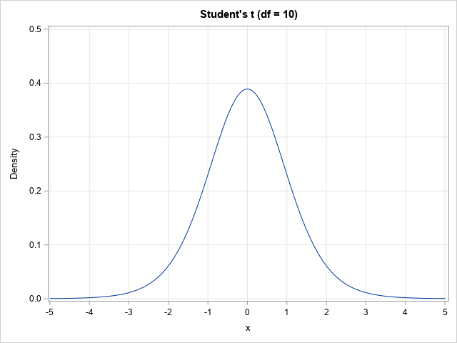
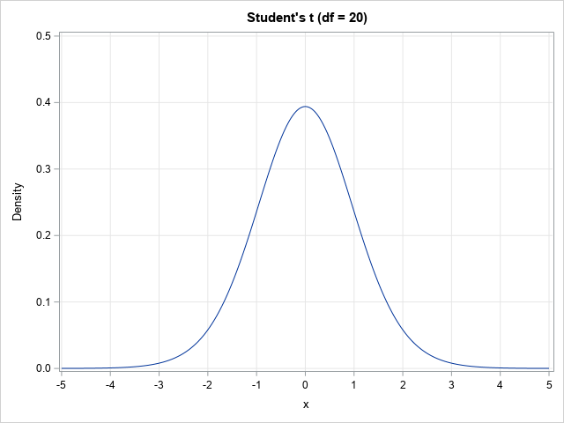
Continuous – Student’s t Distribution
Python Function | Density | Distribution | Significance | Quantile | Random Number
scipy.stats.t | .pdf() | .cdf() | .sf() | .ppf() | .rvs()

Slide 57
Regression Test
IF the feature is statistically independent of the target variable, then the feature will not help predict the target variable
THEN the regression coefficient $β$ is zero
THEN the regression coefficient 𝛽 is zero
THEREFORE, the absolute value of statistic $t=\frac{\hat{β}}{se\left(\hat{β}\right)}$ should be small.
THEREFORE, the absolute value of statistic 𝑡=𝛽 ̂/se(𝛽 ̂ ) should be small.

Slide 58
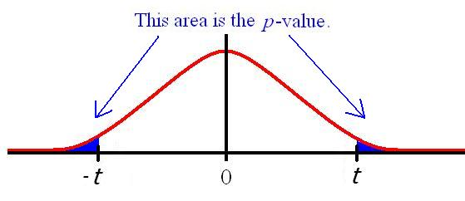
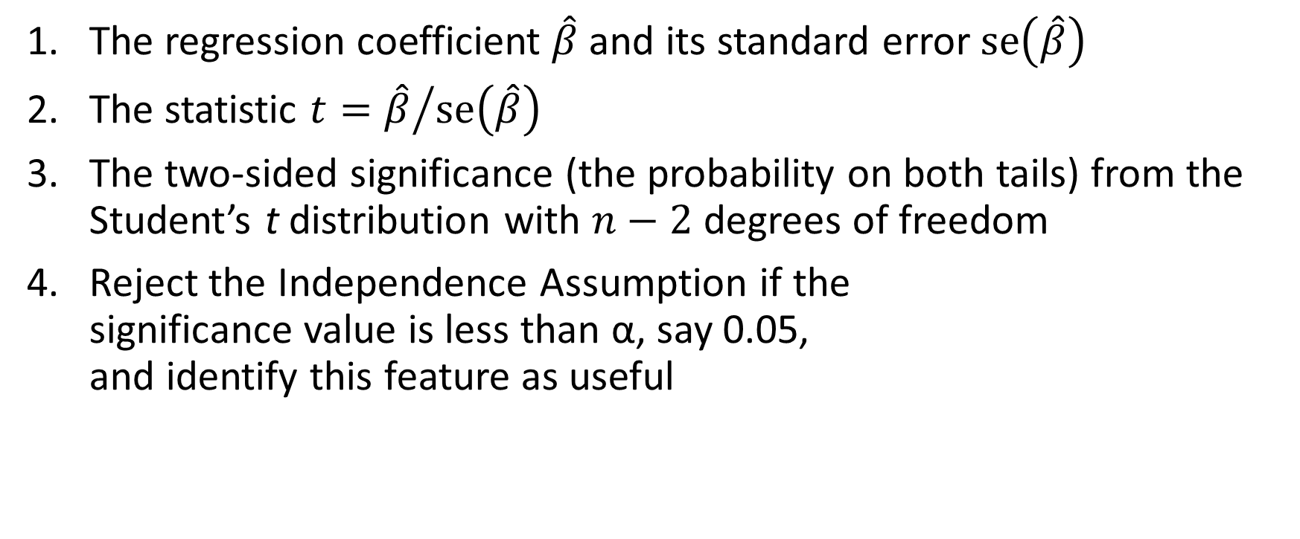
Student’s t Test - Procedure
The regression coefficient $\hat{β}$ and its standard error $se\left(\hat{β}\right)$
The statistic $t={\hat{β}}/{se\left(\hat{β}\right)}$
The two-sided significance (the probability on both tails) from the Student’s t distribution with $n−2$ degrees of freedom
Reject the Independence Assumption if the significance value is less than α, say 0.05, and identify this feature as useful

Slide 59
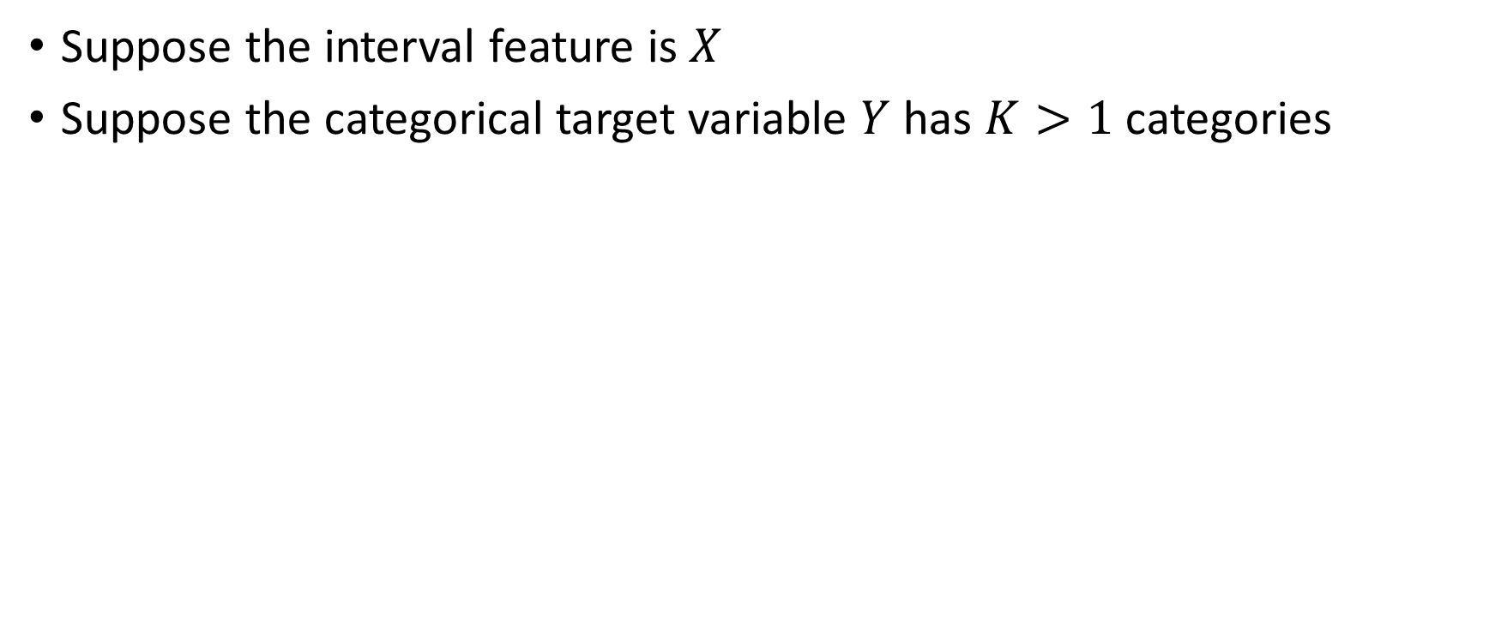
Deviance Test
Suppose the interval feature is $X$
Suppose the categorical target variable $Y$ has $K>1$ categories
IF the feature is statistically independent of the target variable, then the feature will not help predict the target variable
THEN the goodness-of-fit of a logistic model with the interval feature $X$ should be the same as another logistic model without the interval feature is $X$
THEN the goodness-of-fit of a logistic model with the interval feature 𝑋 should be the same as another logistic model without the interval feature is 𝑋
THEREFORE, the Deviance statistic should be small

Slide 60
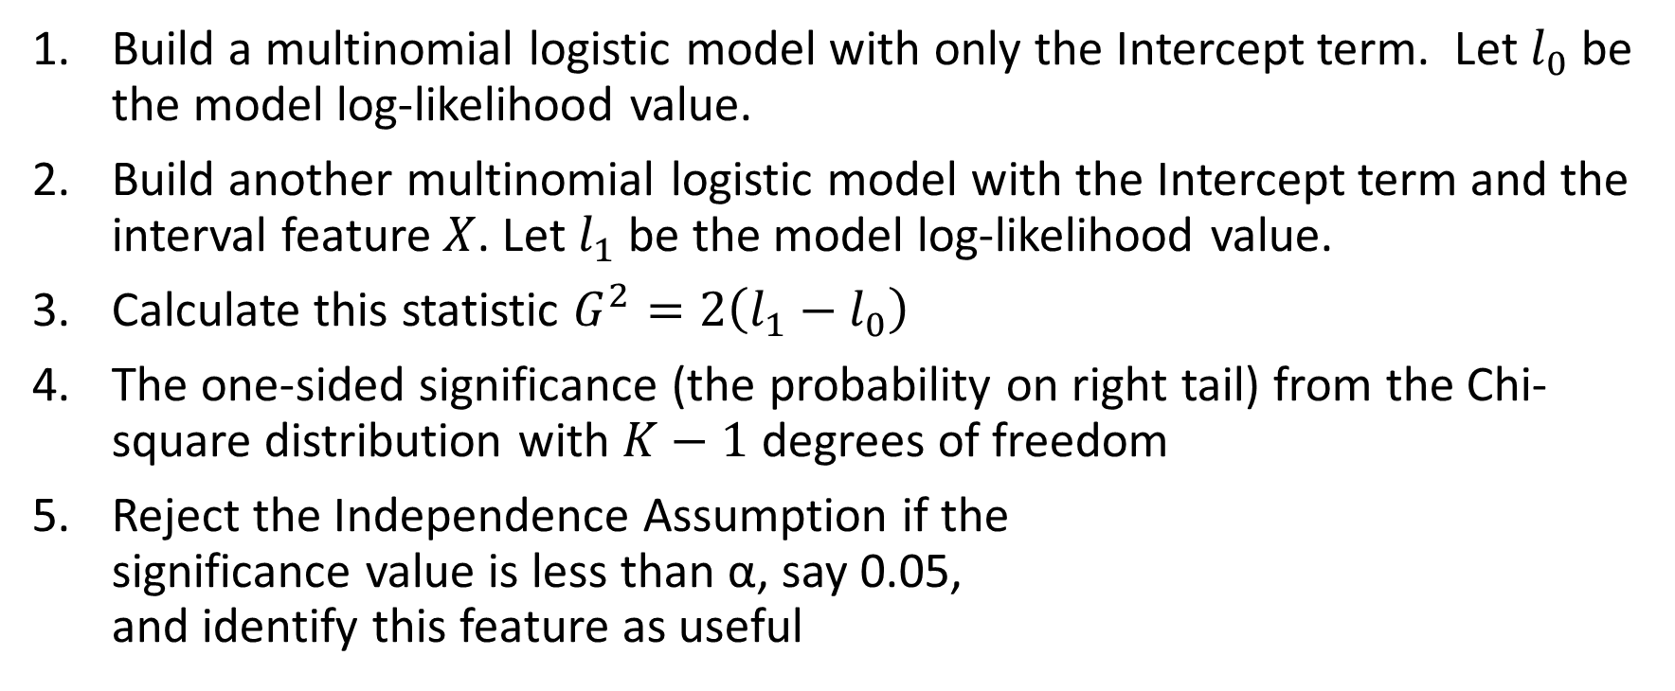
Deviance Test - Procedure
Build a multinomial logistic model with only the Intercept term. Let $l_{0}$ be the model log-likelihood value.
Build another multinomial logistic model with the Intercept term and the interval feature $X$. Let $l_{1}$ be the model log-likelihood value.
Calculate this statistic $G^{2}=2\left(l_{1}−l_{0}\right)$
The one-sided significance (the probability on right tail) from the Chi-square distribution with $K−1$ degrees of freedom
Reject the Independence Assumption if the significance value is less than α, say 0.05, and identify this feature as useful

Slide 61
The Home Equity Loan Example
Categorical Feature: REASON, JOB, DEROG, DELINQ, and NINQ
Interval Feature: LOAN, MORTDUE, VALUE, YOJ, CLAGE, CLNO, and DEBTINC
5,960 records, 13 variables read from hmeq.csv
3,364 complete records analyzed
Chi-square Test for categorical features
Deviance Test for Interval Feature
Categorical Target Variable: BAD
Ranking based on Significance

Slide 62
The Home Equity Loan Example
# Define a function that performs the Chi-square test
def ChiSquareTest (
xCat, # input categorical feature
yCat, # input categorical target variable
debug = 'N' # debugging flag (Y/N)
):
obsCount = pandas.crosstab(index = xCat, columns = yCat, margins = False, dropna = True)
cTotal = obsCount.sum(axis = 1)
rTotal = obsCount.sum(axis = 0)
nTotal = numpy.sum(rTotal)
expCount = numpy.outer(cTotal, (rTotal / nTotal))
chiSqStat = ((obsCount - expCount)**2 / expCount).to_numpy().sum()
chiSqDf = (obsCount.shape[0] - 1.0) * (obsCount.shape[1] - 1.0)
chiSqSig = scipy.stats.chi2.sf(chiSqStat, chiSqDf)
return(chiSqStat, chiSqDf, chiSqSig)
Week 9 Identify Useful Feature for Cat Target.py

Slide 63
The Home Equity Loan Example
# Define a function that performs the Deviance test
def DevianceTest (
xInt, # input interval feature
yCat, # input categorical target variable
debug = 'N' # debugging flag (Y/N)
):
y = yCat.astype('category')
# Model 0 is yCat = Intercept
X = numpy.where(yCat.notnull(), 1, 0)
objLogit = smodel.MNLogit(y, X)
thisFit = objLogit.fit(method = 'newton', full_output = True, maxiter = 100, tol = 1e-8)
thisParameter = thisFit.params
LLK0 = objLogit.loglike(thisParameter.values)
# Model 1 is yCat = Intercept + xInt
X = smodel.add_constant(xInt, prepend = True)
objLogit = smodel.MNLogit(y, X)
thisFit = objLogit.fit(method = 'newton', full_output = True, maxiter = 100, tol = 1e-8)
thisParameter = thisFit.params
LLK1 = objLogit.loglike(thisParameter.values)
# Calculate the deviance
devianceStat = 2.0 * (LLK1 - LLK0)
devianceDf = (len(y.cat.categories) - 1.0)
devianceSig = scipy.stats.chi2.sf(devianceStat, devianceDf)
return(devianceStat, devianceDf, devianceSig)
Week 9 Identify Useful Feature for Cat Target.py

Slide 64
The Home Equity Loan Example
# The Home Equity Loan example
catPred = ['REASON', 'JOB', 'DEROG', 'DELINQ', 'NINQ']
intPred = ['LOAN', 'MORTDUE', 'VALUE', 'YOJ', 'CLAGE', 'CLNO', 'DEBTINC']
hmeq = pandas.read_csv('C:\\Users\\minlam\\Documents\\IIT\\Machine Learning\\Data\\hmeq.csv',
delimiter=',', usecols = ['BAD']+catPred+intPred)
hmeq = hmeq.dropna()
testResult = pandas.DataFrame(index = catPred + intPred,
columns = ['Test', 'Statistic', 'DF', 'Significance'])
for pred in catPred:
chiSqStat, chiSqDf, chiSqSig = ChiSquareTest(hmeq[pred], hmeq['BAD'], debug = 'Y')
testResult.loc[pred] = ['Chi-square', chiSqStat, chiSqDf, chiSqSig]
for pred in intPred:
devianceStat, devianceDf, devianceSig = DevianceTest(hmeq[pred], hmeq['BAD'], debug = 'Y')
testResult.loc[pred] = ['Deviance', devianceStat, devianceDf, devianceSig]
rankSig = testResult.sort_values('Significance', axis = 0, ascending = True)
Week 9 Identify Useful Feature for Cat Target.py

Slide 65
The Home Equity Loan Example
Feature | Test | Statistic | DF | Significance
DELINQ | Chi-square | 302.7277966 | 9 | 6.89E-60
DEROG | Chi-square | 237.8856927 | 10 | 1.90E-45
DEBTINC | Deviance | 144.4416285 | 1 | 2.84E-33
NINQ | Chi-square | 97.5806366 | 12 | 1.66E-15
CLAGE | Deviance | 50.6898168 | 1 | 1.08E-12
JOB | Chi-square | 36.2546912 | 5 | 0.0000008
YOJ | Deviance | 14.8204053 | 1 | 0.0001182
LOAN | Deviance | 3.5110923 | 1 | 0.0609593
VALUE | Deviance | 2.4397505 | 1 | 0.1182950
MORTDUE | Deviance | 0.9512081 | 1 | 0.3294120
CLNO | Deviance | 0.1896254 | 1 | 0.6632286
REASON | Chi-square | 0.1312973 | 1 | 0.7170907

Slide 66
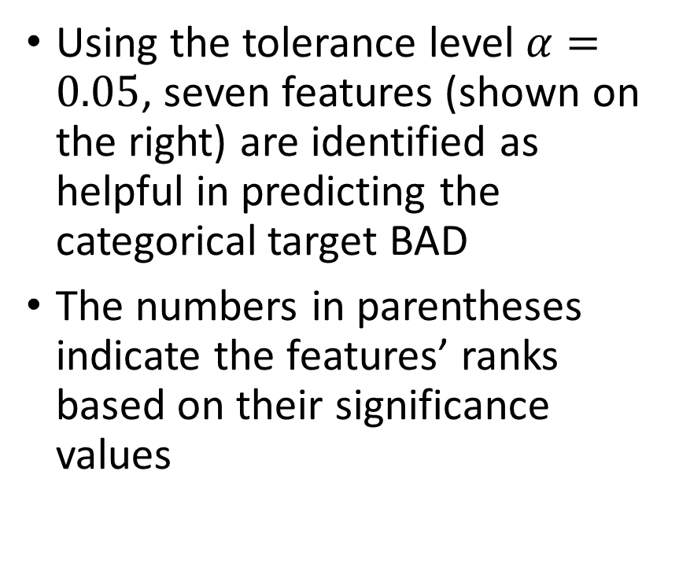
The Home Equity Loan Example
Using the tolerance level $α=0.05$, seven features (shown on the right) are identified as helpful in predicting the categorical target BAD
The numbers in parentheses indicate the features’ ranks based on their significance values
Categorical
DELINQ (1)
Interval
CLAGE (5)
DEROG (2)
NINQ (4)
JOB (6)
DEBTINC (3)
YOJ (7)

Slide 67

Feature Importance
Feature | Test | Statistic | DF | Significance
DELINQ | Chi-square | 302.7277966 | 9 | 6.89E-60
DEROG | Chi-square | 237.8856927 | 10 | 1.90E-45
DEBTINC | Deviance | 144.4416285 | 1 | 2.84E-33
NINQ | Chi-square | 97.5806366 | 12 | 1.66E-15
CLAGE | Deviance | 50.6898168 | 1 | 1.08E-12
JOB | Chi-square | 36.2546912 | 5 | 0.0000008
YOJ | Deviance | 14.8204053 | 1 | 0.0001182
In the previous example, the significances of seven features are less than 0.05.
Among them:
DELINQ has the smallest significance at 6.89E-60
YOJ has the largest significance at 0.0001182
Do these significances carry the same weights in our decision?
Do these significances indicate that some features are more important than others?

Slide 68
Common Measures for Feature Importance
Significance
Rank significances on the logarithm scale
Suppose the significance of a statistical test is $0<p≤1$, then calculate importance as $−\log_{10}\left(p\right)$.
Suppose the significance of a statistical test is 0<𝑝≤1, then calculate importance as −log_10⁡(𝑝).
Association
Measure the strength of association
The higher the importance value, the more predictive a feature for the target variable.
Calculate the appropriate statistic for measuring the strength of association between the feature and the target variable.

Slide 69
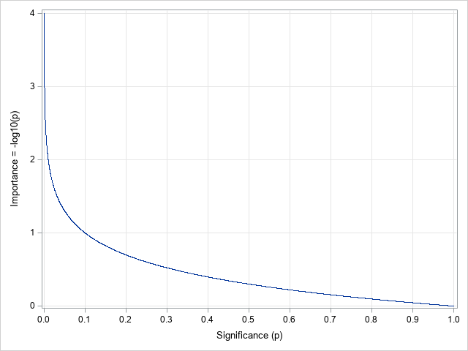

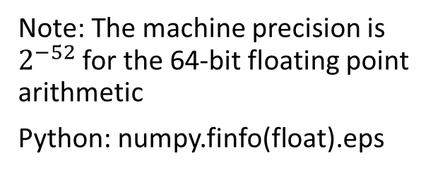
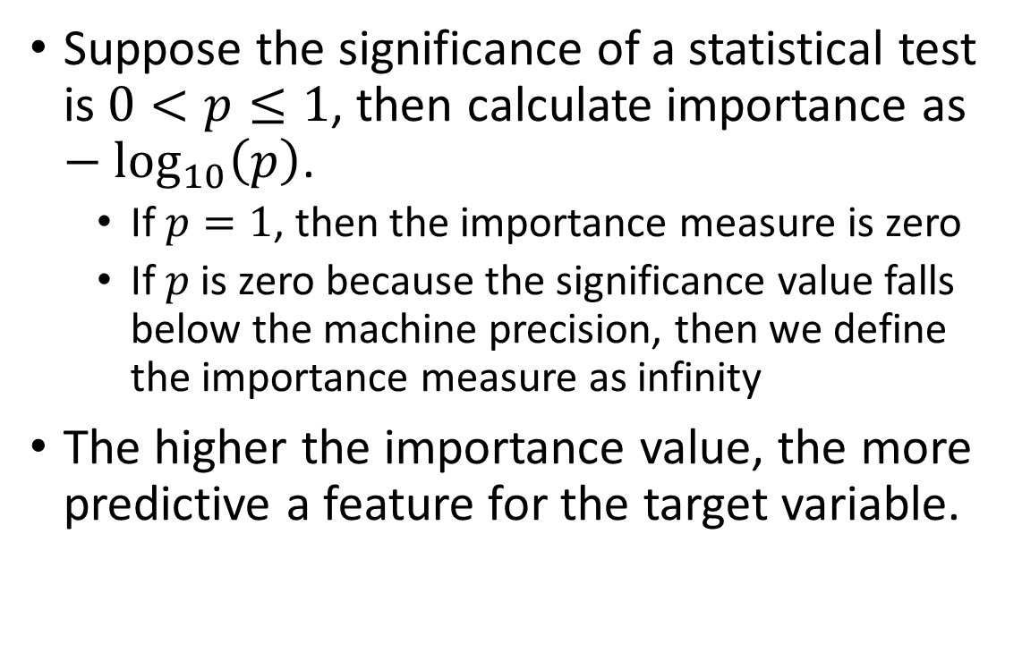
Feature Importance: $−\log_{10}\left(Significance\right)$
Suppose the significance of a statistical test is $0<p≤1$, then calculate importance as $−\log_{10}\left(p\right)$.
If $p=1$, then the importance measure is zero
If $p$ is zero because the significance value falls below the machine precision, then we define the importance measure as infinity
The higher the importance value, the more predictive a feature for the target variable.
Note: The machine precision is $2^{−52}$ for the 64-bit floating point arithmetic
Python: numpy.finfo(float).eps

Slide 70

The Home Equity Loan Example
Feature | Test | Significance | Importance
DELINQ | Chi-square | 6.89E-60 | 59.16
DEROG | Chi-square | 1.90E-45 | 44.72
DEBTINC | Deviance | 2.84E-33 | 32.55
NINQ | Chi-square | 1.66E-15 | 14.78
CLAGE | Deviance | 1.08E-12 | 11.97
JOB | Chi-square | 0.0000008 | 6.10
YOJ | Deviance | 0.0001182 | 3.93
LOAN | Deviance | 0.0609593 | 1.21
VALUE | Deviance | 0.1182950 | 0.93
MORTDUE | Deviance | 0.3294120 | 0.48
CLNO | Deviance | 0.6632286 | 0.18
REASON | Chi-square | 0.7170907 | 0.14
Week 9 Identify Useful Feature for Cat Target.py

Slide 71
Association Based Feature Importance
We prefer the association-based importance measure to be:
Positive
Between zero and one
A higher value indicates more important, and a lower value indicates less important
Appropriate Association Measure |  | Target Variable
 |  | Categorical | Interval
Input Feature | Categorical | Cramer’s V | Eta-squared
 | Interval | McFadden's Pseudo R^2 | Squared Pearson Correlation

Slide 72
Cramer’s V
Suppose the categorical target variable $Y$ has $K>1$ categories
Suppose the categorical feature $X$ has $L>1$ categories
Let $n_{ij}≥0, i=1,…, L$ and $j=1,…,K$ be the number of observations in the $i^{th}$ category of the feature and the $j^{th}$ category of the target.
The marginal counts are:
Across Column: $n_{i+}=\sum_{j=1}^{K}{n_{ij}}$, $i=1,…, L$
Across Row: $n_{+j}=\sum_{i=1}^{L}{n_{ij}}$, $j=1,…,K$
Across Cell: $n_{++}=\sum_{i=1}^{L}{\sum_{j=1}^{K}{n_{ij}}}$

Slide 73

Cramer’s V
The expected count in the $\left(i,j\right)$ cell is $E_{ij}=n_{i+}\frac{n_{+j}}{n_{++}}>0$
The Pearson Chi-square statistic is $χ^{2}=\sum_{i=1}^{L}{\sum_{j=1}^{K}{\frac{{\left(n_{ij}−E_{ij}\right)}^{2}}{E_{ij}}}}$
The Cramer’s V is $V=\sqrt{\frac{χ^{2}}{n_{++} × min\left(K−1, L−1\right)}}$
The Cramer’s V is between 0 and 1
A larger Cramer’s V indicates that a particular category in the feature is associated with a particular category in the target variable

Slide 74

Eta-squared
Within-Group Sum of Squares $SSW=\sum_{i=1}^{L}{\sum_{j=1}^{n_{i}}{{\left(y_{ij}−{\overline{y}}_{i}\right)}^{2}}}$
Total Sum of Squares $SST=\sum_{i=1}^{L}{\sum_{j=1}^{n_{i}}{{\left(y_{ij}−\overline{y}\right)}^{2}}}$
Between-Group Sum of Squares $SSG=SST−SSW$
The Eta-squared is $η^{2}=\frac{SSG}{SST}$
The Eta-squared is between 0 and 1
A larger $η^{2}$indicates that the means of the target variable in the feature’s categories are different.

Slide 75

Squared Pearson Correlation
Suppose $\left(x_{i}, y_{i}\right), i=1,…,n$ are the pairs of values for the feature $X$ and the target variable $Y$.
Let $\overline{x}=\frac{1}{n}\sum_{i=1}^{n}{x_{i}}$ be the mean of the feature
Let $\overline{y}=\frac{1}{n}\sum_{i=1}^{n}{y_{i}}$ be the mean of the target variable
The squared Pearson correlation is $r^{2}=\frac{{\left(\sum_{i=1}^{n}{\left(x_{i}−\overline{x}\right)\left(y_{i}−\overline{y}\right)}\right)}^{2}}{\left(\sum_{i=1}^{n}{{\left(x_{i}−\overline{x}\right)}^{2}}\right)\left(\sum_{i=1}^{n}{{\left(y_{i}−\overline{y}\right)}^{2}}\right)}$
The squared Pearson correlation is between 0 and 1
A larger $r^{2}$ indicates that the larger-than-mean feature values are associated with larger (or smaller)-than-mean target values

Slide 76

McFadden's Pseudo R^2
Build a multinomial logistic model with only the Intercept term. Let $l_{0}$ be the model log-likelihood value.
Build another multinomial logistic model with the Intercept term and the interval feature $X$. Let $l_{1}$ be the model log-likelihood value.
The McFadden’s Pseudo R-squared is $R_{McF}^{2}=1−\frac{l_{1}}{l_{0}}$
The McFadden’s Pseudo R-squared is between 0 and 1
If the interval feature does not help predict the categorical target, then $l_{1}=l_{0}$ and $R_{McF}^{2}=0$.
If the interval feature completely predicts the categorical target (i.e., complete separation), then $l_{1}=0$ and $R_{McF}^{2}=1$.

Slide 77
The Home Equity Loan Example
# Define a function that performs the Chi-square test
def ChiSquareTest (
xCat, # input categorical feature
yCat, # input categorical target variable
debug = 'N' # debugging flag (Y/N)
):
obsCount = pandas.crosstab(index = xCat, columns = yCat, margins = False, dropna = True)
cTotal = obsCount.sum(axis = 1)
rTotal = obsCount.sum(axis = 0)
nTotal = numpy.sum(rTotal)
expCount = numpy.outer(cTotal, (rTotal / nTotal))
chiSqStat = ((obsCount - expCount)**2 / expCount).to_numpy().sum()
chiSqDf = (obsCount.shape[0] - 1.0) * (obsCount.shape[1] - 1.0)
chiSqSig = scipy.stats.chi2.sf(chiSqStat, chiSqDf)
cramerV = chiSqStat / nTotal
if (cTotal.size > rTotal.size):
cramerV = cramerV / (rTotal.size - 1.0)
else:
cramerV = cramerV / (cTotal.size - 1.0)
cramerV = numpy.sqrt(cramerV)
return(chiSqStat, chiSqDf, chiSqSig, cramerV)
Week 9 Identify Useful Feature for Cat Target.py

Slide 78
The Home Equity Loan Example
# Define a function that performs the Deviance test
def DevianceTest (
xInt, # input interval feature
yCat, # input categorical target variable
debug = 'N' # debugging flag (Y/N)
):
y = yCat.astype('category')
# Model 0 is yCat = Intercept
X = numpy.where(yCat.notnull(), 1, 0)
objLogit = smodel.MNLogit(y, X)
thisFit = objLogit.fit(method = 'newton', full_output = True, maxiter = 100, tol = 1e-8)
thisParameter = thisFit.params
LLK0 = objLogit.loglike(thisParameter.values)
# Model 1 is yCat = Intercept + xInt
X = smodel.add_constant(xInt, prepend = True)
objLogit = smodel.MNLogit(y, X)
thisFit = objLogit.fit(method = 'newton', full_output = True, maxiter = 100, tol = 1e-8)
thisParameter = thisFit.params
LLK1 = objLogit.loglike(thisParameter.values)
# Calculate the deviance
devianceStat = 2.0 * (LLK1 - LLK0)
devianceDf = (len(y.cat.categories) - 1.0)
devianceSig = scipy.stats.chi2.sf(devianceStat, devianceDf)
mcFaddenRSq = 1.0 - (LLK1 / LLK0)
return(devianceStat, devianceDf, devianceSig, mcFaddenRsq)
Week 9 Identify Useful Feature for Cat Target.py

Slide 79
The Home Equity Loan Example
# The Home Equity Loan example
catPred = ['REASON', 'JOB', 'DEROG', 'DELINQ', 'NINQ']
intPred = ['LOAN', 'MORTDUE', 'VALUE', 'YOJ', 'CLAGE', 'CLNO', 'DEBTINC']
hmeq = pandas.read_csv('C:\\Users\\minlam\\Documents\\IIT\\Machine Learning\\Data\\hmeq.csv',
delimiter=',', usecols = ['BAD']+catPred+intPred)
hmeq = hmeq.dropna()
testResult = pandas.DataFrame(index = catPred + intPred,
columns = ['Test', 'Statistic', 'DF', 'Significance', 'Association', 'Measure'])
for pred in catPred:
chiSqStat, chiSqDf, chiSqSig, cramerV = ChiSquareTest(hmeq[pred], hmeq['BAD'], debug = 'Y')
testResult.loc[pred] = ['Chi-square', chiSqStat, chiSqDf, chiSqSig, 'Cramer''V', cramerV]
for pred in intPred:
devianceStat, devianceDf, devianceSig, mcFaddenRSq = DevianceTest(hmeq[pred], hmeq['BAD'], debug = 'Y')
testResult.loc[pred] = ['Deviance', devianceStat, devianceDf, devianceSig, 'McFadden''s R^2', mcFaddenRSq]
rankSig = testResult.sort_values('Significance', axis = 0, ascending = True)
rankAssoc = testResult.sort_values('Measure', axis = 0, ascending = False)
Week 9 Identify Useful Feature for Cat Target.py

Slide 80

The Home Equity Loan Example
Feature | Association | Measure
DELINQ | CramerV | 0.2999840
DEROG | CramerV | 0.2659232
NINQ | CramerV | 0.1703154
JOB | CramerV | 0.1038136
DEBTINC | McFaddens R^2 | 0.0714112
CLAGE | McFaddens R^2 | 0.0250608
YOJ | McFaddens R^2 | 0.0073271
REASON | CramerV | 0.0062474
LOAN | McFaddens R^2 | 0.0017359
VALUE | McFaddens R^2 | 0.0012062
MORTDUE | McFaddens R^2 | 0.0004703
CLNO | McFaddens R^2 | 9.375E-05
Week 9 Identify Useful Feature for Cat Target.py

Slide 81
The Home Equity Loan Example
Feature | Test | Significance
DELINQ | Chi-square | 6.89E-60
DEROG | Chi-square | 1.90E-45
DEBTINC | Deviance | 2.84E-33
NINQ | Chi-square | 1.66E-15
CLAGE | Deviance | 1.08E-12
JOB | Chi-square | 0.0000008
YOJ | Deviance | 0.0001182
LOAN | Deviance | 0.0609593
VALUE | Deviance | 0.1182950
MORTDUE | Deviance | 0.3294120
CLNO | Deviance | 0.6632286
REASON | Chi-square | 0.7170907
Feature | Association | Measure
DELINQ | CramerV | 0.2999840
DEROG | CramerV | 0.2659232
NINQ | CramerV | 0.1703154
JOB | CramerV | 0.1038136
DEBTINC | McFaddens R^2 | 0.0714112
CLAGE | McFaddens R^2 | 0.0250608
YOJ | McFaddens R^2 | 0.0073271
REASON | CramerV | 0.0062474
LOAN | McFaddens R^2 | 0.0017359
VALUE | McFaddens R^2 | 0.0012062
MORTDUE | McFaddens R^2 | 0.0004703
CLNO | McFaddens R^2 | 9.375E-05
Week 9 Identify Useful Feature for Cat Target.py

Slide 82
Remarks on Feature Importance
Significance-based metric depends on the statistical power of the test in rejecting the Independence Assumption
Association-based metric may have different interpretation between categorical and interval features

